Slide 1
DAO Acquisition
April 2022

Slide 2
Agenda
Introductions
Why did we purchase DAO? Overview of 2021/2022 so far What’s next for DAO?
New initiatives for your feedback
Off spec (which products, how should it work) Visibility of participants
New Products More trade data
Any other business

Slide 3
Reasons for purchasing DAO
The acquisition of DAO will increase trust in the platform as Nui is industry agnostic and does not trade on the platform.
Nui gains a clearer view of customer needs as we are closer to end users. This allows us to form closer relationships with customers.
Nui can now offer more flexibility to both buyers and sellers. We can facilitate buyers and sellers moving from DAO to a single seller platform and vice-versa.
Nui can more easily merge over development from other platforms to the DAO platform.
100% Independent
from 1 April 2022

Slide 4
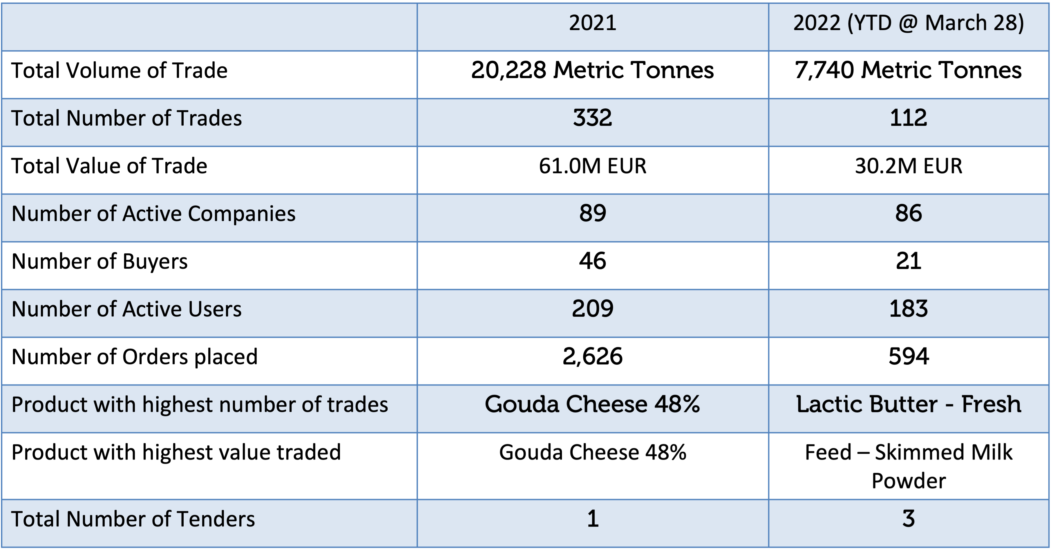
Overview of 2021/2022

Slide 5
Recent successes on DAO
Procurement tenders - https://vimeo.com/690494292/02c758344d
New and returning customers since acquisition announced
Increased volumes in Q1 – reflecting the value of digital trade in current market conditions

Slide 6
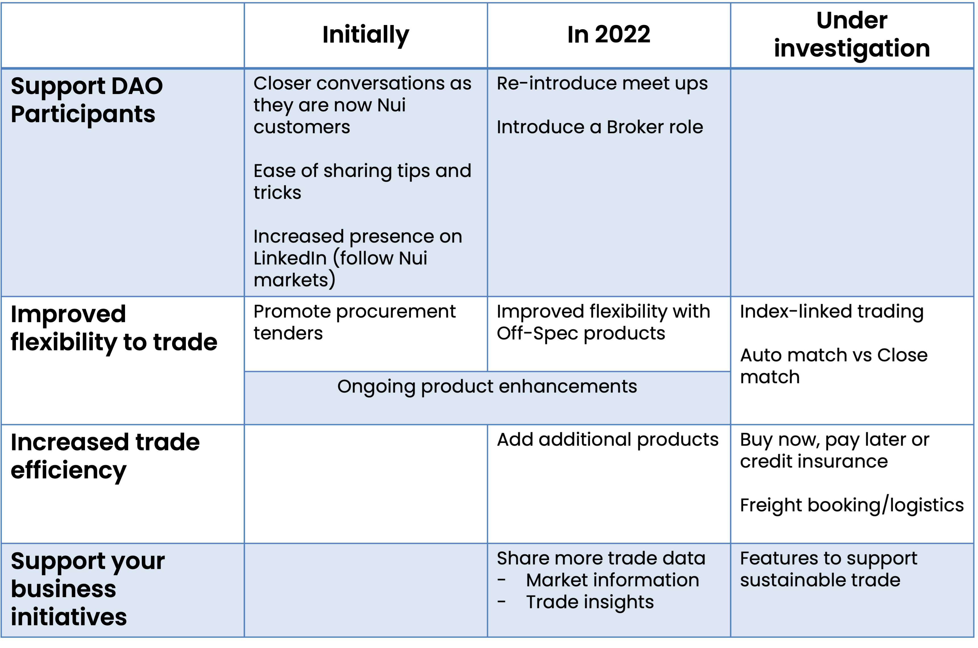
What’s next for DAO - simplifying to give you more

Slide 7
New initiatives for your feedback

Slide 8
Out of Spec products on DAO
The definition of Out of Spec is broad – it can include under-grade, down-grade, feed-grade or even just ageing products.
Current
Some feed grade products are offered on DAO.
Age logic gives visibility of the age of some products.
What happens on other Nui platforms
Similar to DAO feed products – Out of spec reasons defined as part of the spec. Regular weekly sales of mixed load down-grade products using attachments and comments to express details of the offer.
Possibilities for DAO
Off Spec products listed in a separate DAO area – similar to an outlet store? Off Spec products listed alongside in-side with the ability to filter?
Clearer definition of reasons of off-spec within the order ticket (age, micro, protein etc) for more detailed filtering.
Introduce addition of attachments or photos for one off out of spec loads?

Slide 9
Visibility of participants
Outside of Europe, participants are seeking more transparent trade.
What this means for participants:

Slide 10
New products
Would you be interested in trading organic products on DAO?
Would you be interested in trading any other new products on DAO? What would you like to be enabled on DAO?

Slide 11
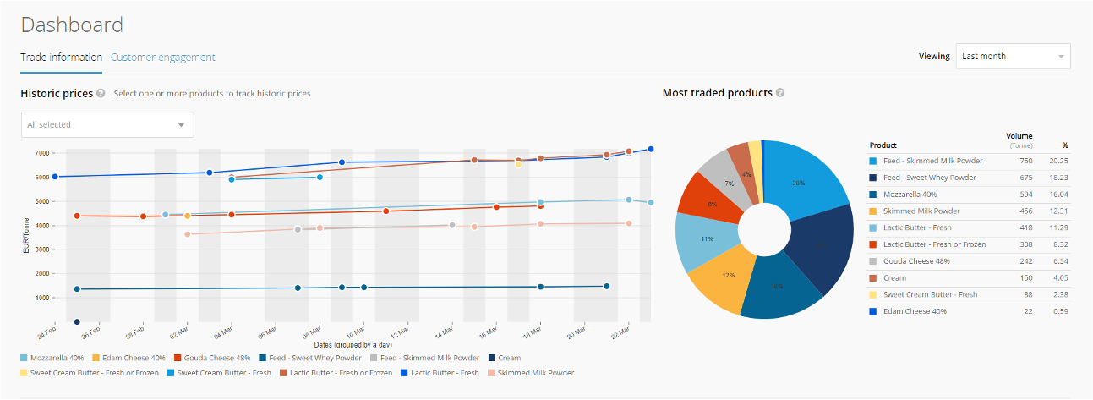
More trade data
A detailed and flexible view of trade data – available for all DAO participants?

Slide 12
Under investigation – what piques your interest?
Sustainability initiatives
Show your certification on the platform Carbon neutral trading
Would you use…
Close match instead of Auto match – Auto matches are very rare on DAO. We’re imagining a future where instead you get an easy view of order similar to yours, or ‘recommended for you’
Open price offers on DAO for easy price discovery Buy now, Pay Later or Credit Insurance
Shipment booking, tracking and documentation
Index based trading

Slide 13
A sneak peak
Coming your way in April
And later in 2022

Slide 14
Thank you!

