Slide 1
DAO Acquisition - Nui Markets April 2022

Slide 2
Agenda
1. Introductions
2. Why did we purchase DAO?
3. Overview of 2021/2022 so far
4. Where next for DAO
5. New initiatives for your feedback
- Off spec (Which products, how should it work)
- Visibility of participants
- New products
- More trade data
6. Any other business

Slide 3
Reason for purchasing DAO & Overview
The acquisition of DAO will increase trust in the platform as Nui is industry agnostic and does not trade on the platform
100% independent from 1 April 2022
Nui gains a clearer view of customer needs as we are closer to end users. This allows us to form closer relationships with customers.
Nui can now offer more flexibility to both buyers and sellers. We can facilitate buyers and sellers moving from DAO to a single seller platform and vice-versa.
Nui can more easily merge over development from other platforms to the DAO platform.

Slide 4
Overview of 2021 / 2022
 | 2021 | 2022 (YTD @ March 28)
Total Volume of Trade | 20,228 Metric Tonnes | 7,740 Metric Tonnes
Total Number of Trades | 332 | 112
Total Value of Trade | 61.0M EUR | 30.2M EUR
Number of Active Companies | 89 | 86
Number of Buyers | 46 | 21
Number of Active Users | 209 | 183
Number of Orders placed | 2,626 | 594
Product with highest number of trades | Gouda Cheese 48% | Lactic Butter - Fresh
Product with highest value traded | Gouda Cheese 48% | Feed – Skimmed Milk Powder
Total Number of Tenders | 1 | 3

Slide 5
Recent successes on DAO
1. Procurement tenders - https://vimeo.com/690494292/02c758344d
2. New and returning customers since acquisition announced
3. Increased volumes in Q1 – reflecting the value of digital trade in current market conditions

Slide 6
Where next for DAO – simplifying to give you more
 | Initially | In 2022 | Under investigation
Support DAO Participants | Closer conversations as they are now Nui customers Ease of sharing tips and tricks Increased presence on LinkedIn (follow Nui markets) | Re-introduce meet ups Introduce a Broker role
Improved flexibility to trade | Promote procurement tenders | Improved flexibility with Off-Spec products | Index-linked trading Auto match vs Close match
 | Ongoing product enhancements
Increased trade efficiency |  | Add additional products | Buy now, pay later or credit insurance Freight booking/logistics
Support your business initiatives |  | Share more trade data Market information Trade insights | Features to support sustainable trade

Slide 7
Out of Spec products on DAO
The definition of Out of Spec is broad – and can include under-grade, down-grade, feed-grade or even just ageing products
Current
Some feed grade products are offered on DAO.
Age logic gives visibility of the age of some products
What happens on other Nui platforms
Similar to DAO Feed products – Out of spec reasons defined as part of the spec
Regular weekly sales of mixed load down-grade products using attachments and comments to express details of the offer
Possibilities for DAO
- Off Spec products listed in a separate DAO area – similar to an outlet store?
- Off Spec products listed alongside in-side with the ability to filter?
- Clearer definition of reasons of off-spec within the order ticket (eg age, micro, protein etc) for more detailed filtering
- Introduce addition of attachments or photos for one off out of spec loads?

Slide 8
Visibility of participants
Outside of Europe, participants are seeking more transparent trade
What this means for participants:
Anonymous (DAO) | Public
Counterparty is not known until after trade | Counterparty is listed when order is placed
 | Participants have the ability to: Counter Place a private order to one of many
Commercials – Subscription + commission | Commercials – generally subscription only

Slide 9
New Products
Would you be interested in trading organic products on DAO?
Would you be interested in trading any other new products on DAO?
What would you like to be enabled to trade on DAO?

Slide 10
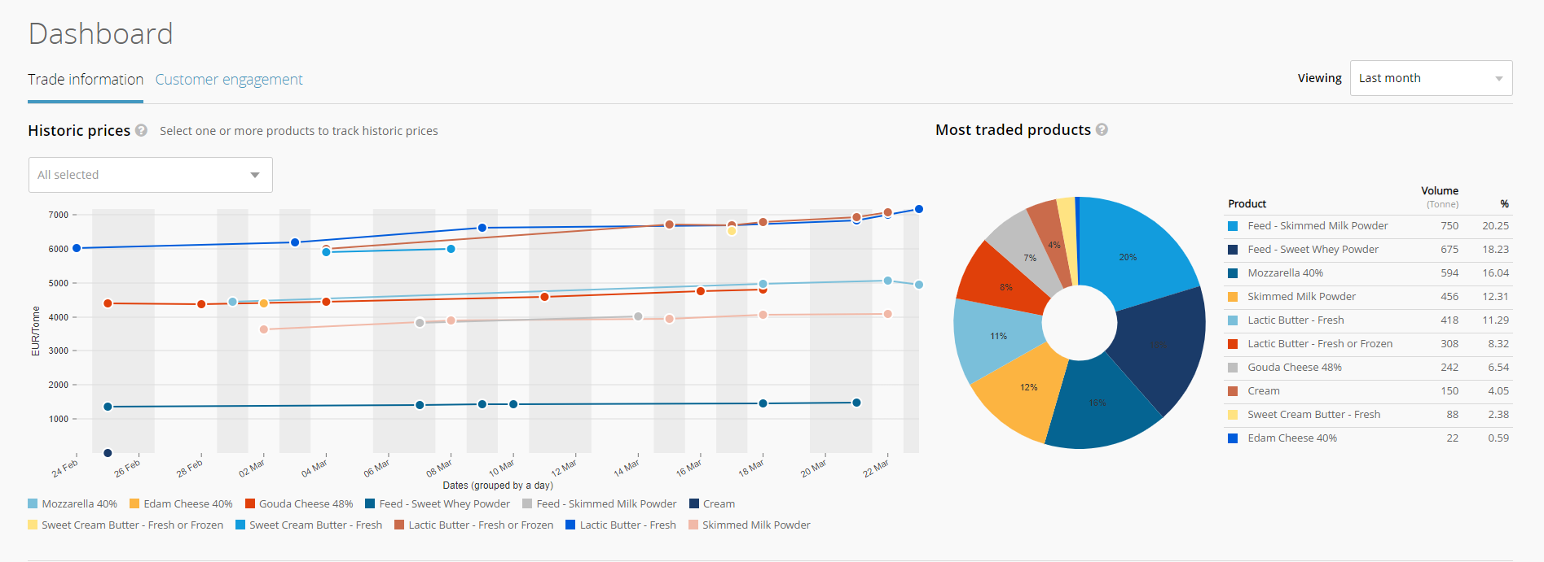
More trade data
A detailed and flexible view of trade data – available for all DAO participants?

Slide 11
Under investigation – what piques your interest?
Sustainability initiatives
Show your certification on the platform
Carbon neutral trading
Would you use…
Close match instead of Auto match – Auto matches are very rare on DAO. We’re imagining a future where instead you get an easy view of order similar to yours, or ‘recommended for you’
Open price offers on DAO for easy price discovery
Buy now Pay Later or Credit Insurance
Shipment booking, tracking and documentation
Index based trading

Slide 12
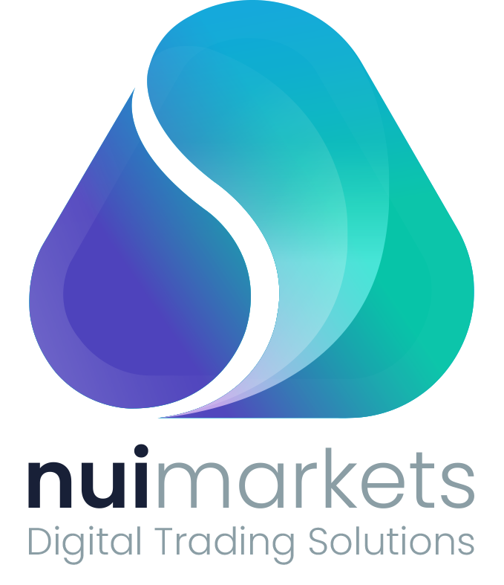
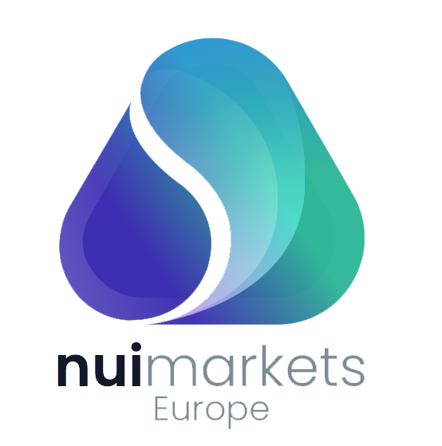
A sneak peek
Coming your way in April
And later in 2022

Slide 13
Thank you!

