Slide 1
Nui Markets – North America
An Open marketplace for the trade of dairy commodities
February 2022

Slide 2
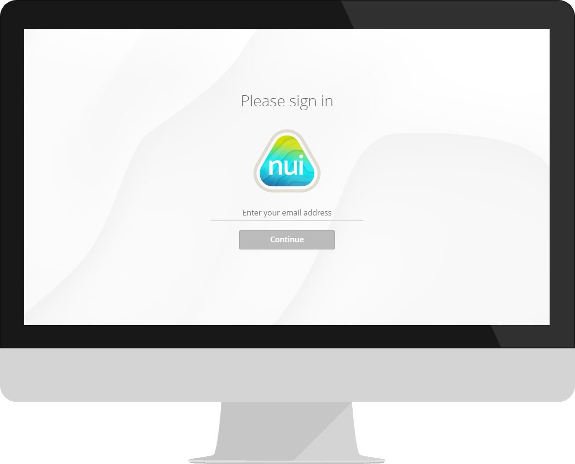
What is Nui Markets – North America?
An open marketplace for dairy commodity trading, initially within North America
Brings together a collection of trading partners, all of whom can buy or sell to pre-approved participants
Offers a standardised product set and rules of trade
Gives participants the opportunity to efficiency source or sell dairy products, anywhere, anytime.
Launching in the US in April 2022

Slide 3
Consistent across all Nui plans
Nui offers multiple plans, to best suit your specific needs. Regardless of which plan you choose, all plans offer the following essentials
Secure, cloud-based infrastructure
Proven technology – our platforms are in regular use by 400+ companies in more than fifty countries
Accessible via desktop or mobile app
Training and 24/7 technical support is available for all participants

Slide 4
Our experience in Dairy
Nui has worked alongside dairy companies across the globe to build an intuitive platform for dairy trade
Private dairy platforms in North America
Nui host private platforms for dairy companies in the US, Europe and New Zealand
40+ U.S based companies participate on these platforms.
In 2021, over 5,000,000 pounds were traded on Nui platforms in the US
Nui Markets in Europe - DAO.EU
DAO.EU is a dairy commodity marketplace based in Europe, established in 2017
In 2021 alone 208 unique users, traded over 44,000,000 pounds of dairy commodities on the DAO platform
Nui takes over ownership of DAO.EU on 1 April 2022, and has plans in place for further growth on this platform

Slide 5
Why use Nui Markets – US?
The key benefits
Gain Market Information
Provides Price discovery and transparency of dairy commodities
When all parties have visibility of the market price, pricing tension is reduced
Improve Trade Efficiency
Days long processes, now happen with just one click
Reduced spend on transactional activity allows for value added activity
Broaden your network
Small and medium companies can easily expand their customer base
Ability to test the market price with a broader group

Slide 6
How do we compare to the CME
What we offer
An open marketplace available 24/7 – ready to use when it works for you.
Broader product set
Real-time market price transparency
Easy to set up, and simple to use
What the CME offer
Scheduled daily event
Defined products
Key purpose is to set an Index that informs the market / sets the farm-gate price

Slide 7
What does it cost?
Monthly subscription
Paid six monthly in Jan and July
For 2022 = $2500
For 2023 = $3000
No commission
No implementation costs
Founding members
Join prior to June 30, 2022
$500 / month reduction in subscription fee for 2022 and 2023

Slide 8
Thank you!

