Slide 1


Nui Markets
Flanders – Sales platform

Slide 2


Why use Nui Markets?
The key benefits
Improved trade efficiency
Days long processes now happen with just one click
Customised price lists no longer required with the Nui freight module
Reduced time and spend on transactional activity allows for value-added activity
Gain market information
Provides price discovery and transparency across markets
Pricing tension is reduced when all parties have
visibility of the market price
Access to Nui’s trade information dashboard
Improved customer experience
Nui’s intuitive user interface, simplifies trade for your customers
A record of all trades, assists with order tracking and reporting

Slide 3
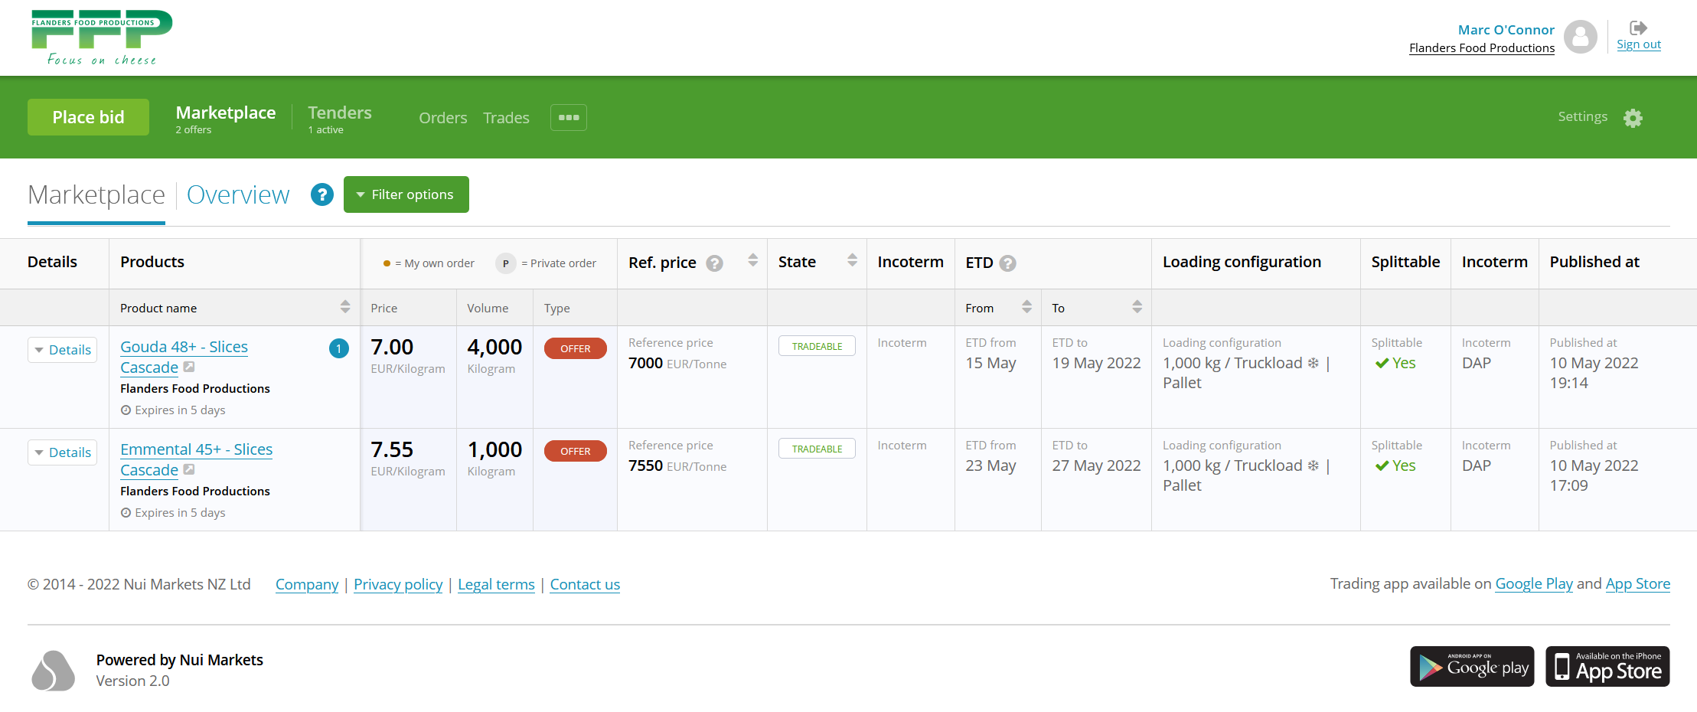




Flanders Marketplace
Offer details (price, volume, loading, ETD, etc) entered by Flanders. Several options available to simplify how product range is displayed
Improved price transparency
Enriched market info
Increased trade efficiency

Slide 4
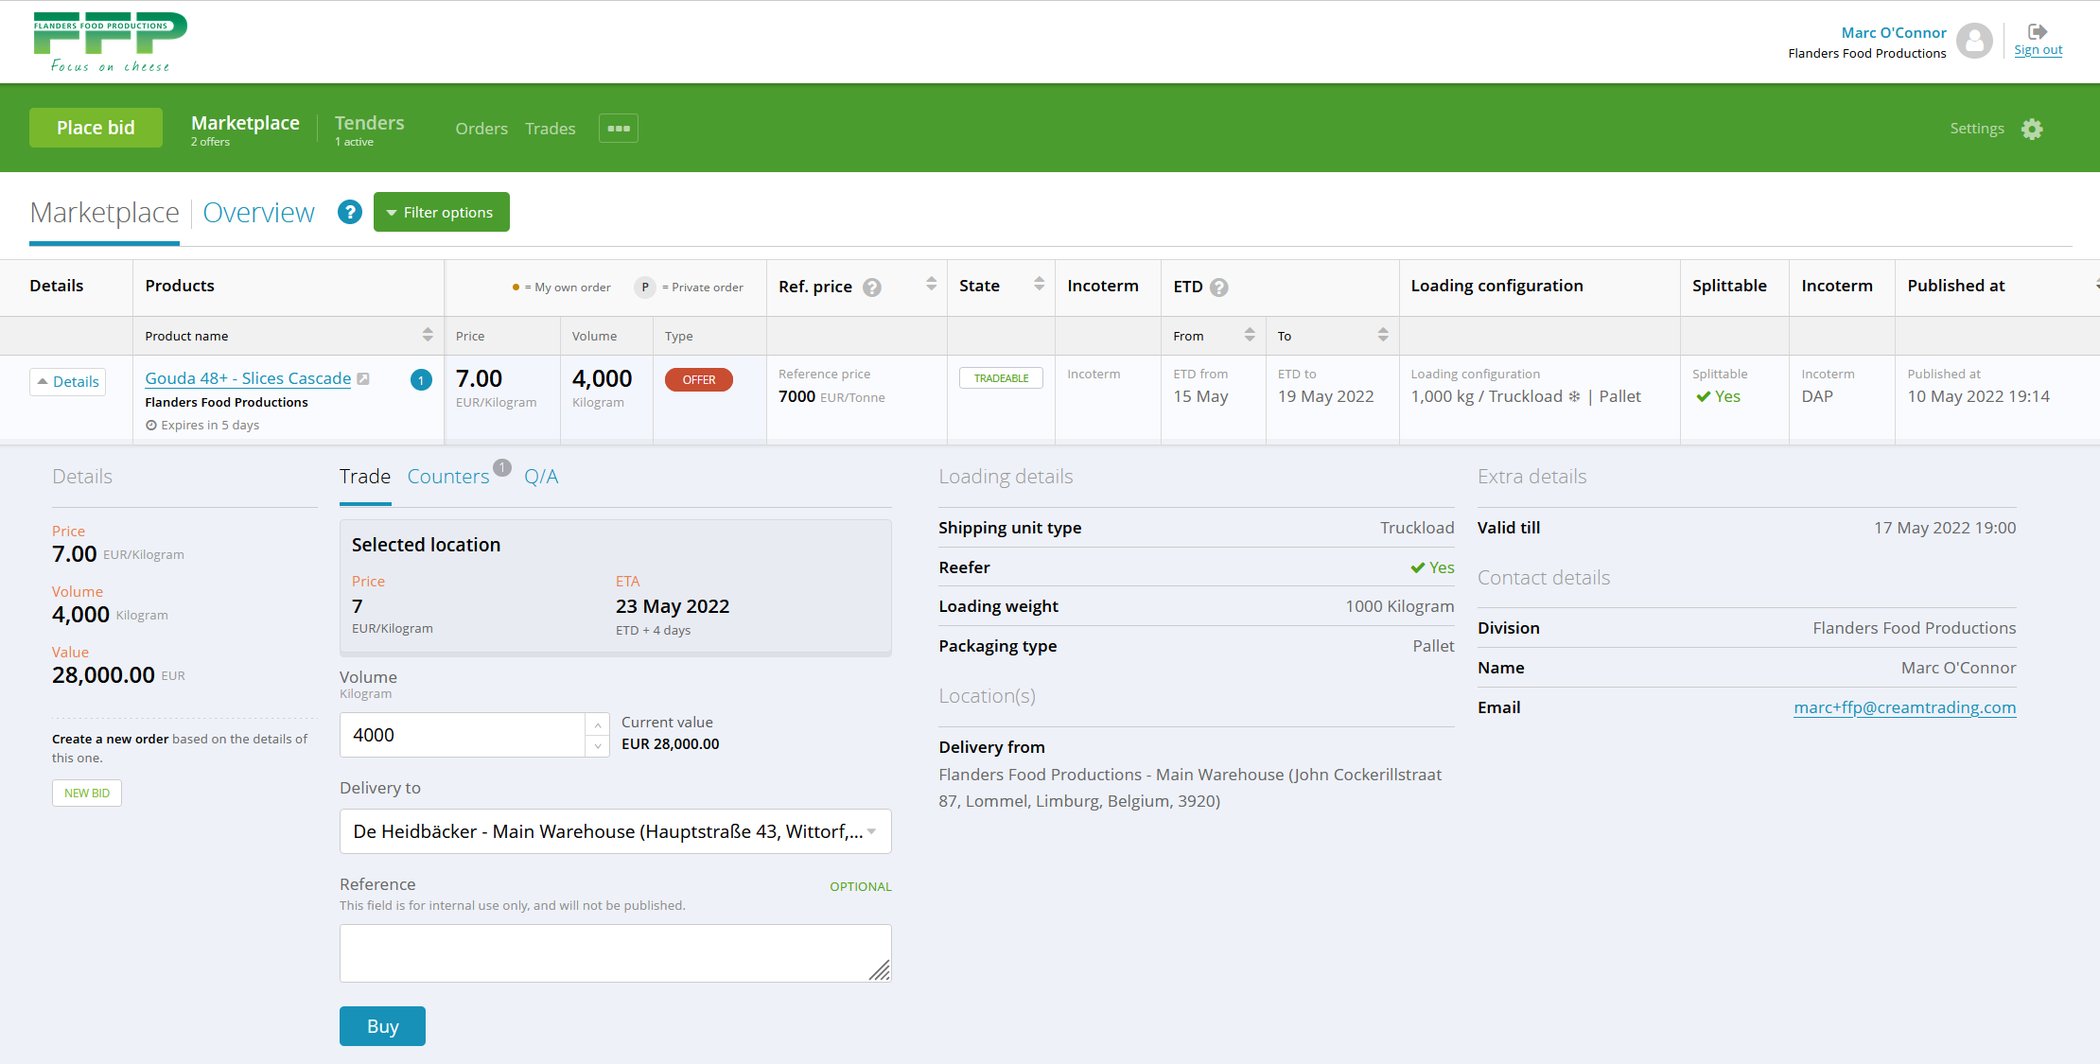
Flanders Marketplace
Customers view delivered price for ‘delivery to’ location
Improved price transparency
Enriched market info
Increased trade efficiency

Slide 5
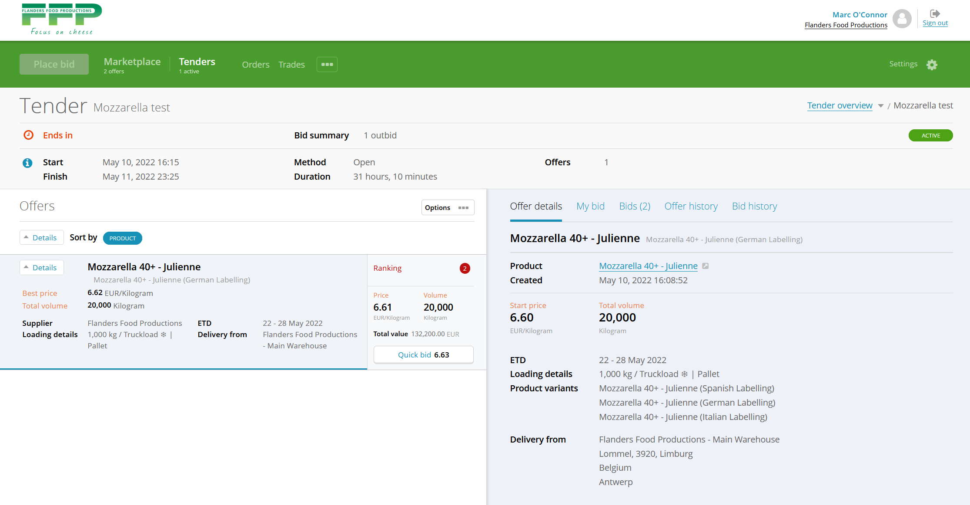
Sales tenders
Tender module available for Flanders if required
Improved price transparency
Enriched market info
Increased trade efficiency

Slide 6
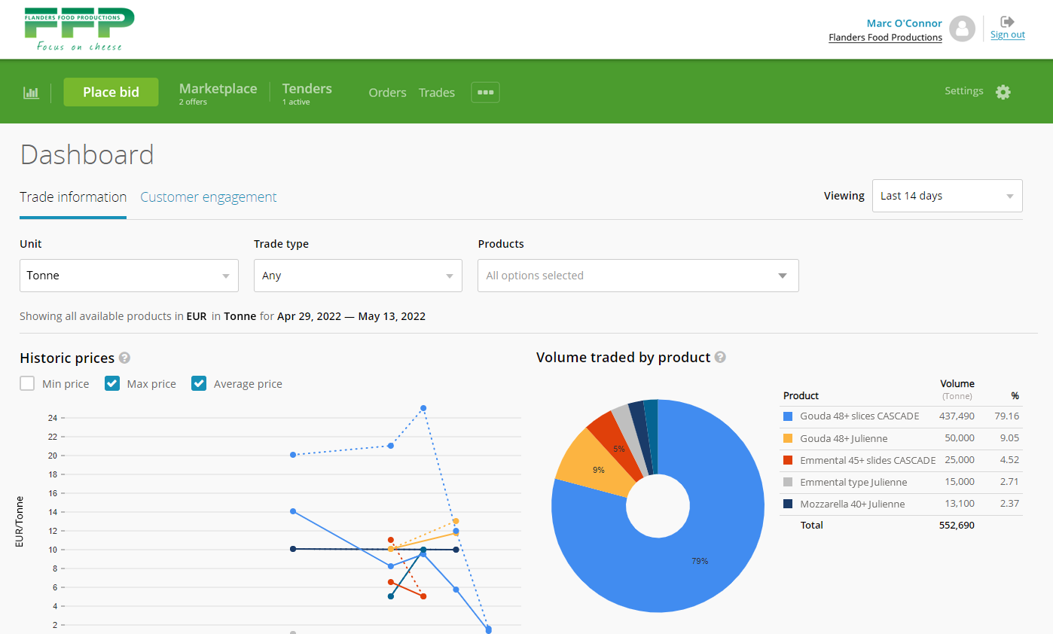
Dashboards
Customer engagement and Trade information can be reviewed using Nui analytics modules
Improved price transparency
Enriched market info
Increased trade efficiency

Slide 7
Consistent across all Nui plans
Nui offers multiple plans, to best suit your specific needs. Regardless of which plan you choose, all plans offer the following essentials
Secure, cloud-based infrastructure
Proven technology - our platforms are in regular use by 400+ companies in more than fifty countries
Accessible via desktop or mobile app
Training and 24/7 technical support is available for all participants

Slide 8
Nui is here to support you
Consistent across all plans
Proven
Our platforms are in regular use by 400+ companies in more than fifty countries
Implementation support
Nui will work with you to determine the most effective set up for products, freight and customers segmentation
Partnership
We don’t just provide the technology. We’ll work with you to achieve your trading goals
Training
Training available for all Flanders staff and customers as required.
24/7 Technical support
Nui staff available via live chat and email
Strategy
In addition to the platform, Nui provides strategic insights on how to optimise the technology and your trade processes

Slide 9
Nui plans – an overview
Nui Essential
For small to medium businesses or larger businesses looking to pilot digital trading.
Includes
Nui Pro
For larger businesses with an estab- lished digital trading strategy.
Nui Advanced
For businesses with a large digital footprint or bespoke needs.
Includes
Includes
Marketplace
Tenders
Marketplace
Tenders
Marketplace
Tenders
Freight
Trade and activity dashboards
Freight
Trade and activity dashboards Custom features
Integration
Implementation Monthly subscription Commission
€50,000
€15,000 0.5%
Implementation | €125,000
Monthly subscription | €20,000
Commission | 0.25%
Implementation Monthly subscription Commission
TBA TBA TBA

Slide 10
Getting started on your Nui implementation
Legal approach
What do you need to do?
Keep it simple
Heads of Agreement
Agreement to negotiate full agreement in good faith after 12 months
Review Nui options
Commit to a pilot
Nui Heads of Agreement
Assign an internal platform owner to work with Nui

Slide 11

Thank you!

