Slide 1
Page 1
Investor Pitch Deck - April 2022
Simplifying the way you trade with our efficient, transparent, digital trade platform.
DRAFT

Slide 2
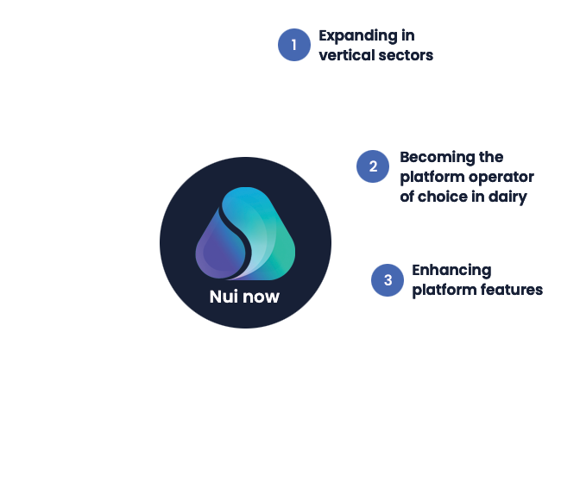
Page 2
Summary
The next chapter
Nui aims to become an industry leader in B2B digital trading of agricultural products through embracing three key paths to growth.
The timing is right to expand. We are looking for a growth capital partner to join our journey.
Nui Markets (Nui) provides a configurable, co-branded platform for B2B digital trading of agricultural products (food and bioenergy)– both as a single seller digital channel and as a multi seller marketplace. This platform is used by 307 companies in 50 countries. Since inception in 2016, NZD$808m of GMV has been traded through our platform. We have identified an opportunity to rapidly expand and consolidate our platform globally. We are now seeking 10m USD of equity capital at a 50m USD pre-money valuation.
This growth capital will enable us to become an industry leader in B2B digital trading through embracing three key paths to growth:
Expand our “platform as a service” offering in new verticals
Become the platform operator of choice in our chosen dairy markets
Enhance platform features to add more value to our users’ trading
Nui is experiencing exponential growth – with 62% annual growth in GMV and almost 200% annual growth in the number of trades through a Nui platform in 2021. With this growth capital, we will truly scale our offering and achieve a forecast 7 times increase in revenue growth over the next four years.
In the last year, we have focused on fine-tuning our core offering of efficient and intuitive online trade. Our flexible model and broad range of trade features enables any trader or exporter, anywhere in the world, to join our ecosystem and trade conveniently. We also collect, anonymize and aggregate a significant amount of trade data through our platforms. We currently provide this data on prices, volumes, and activity to our customers, and we are excited about the opportunity to further monetise this data in the future.
We have a proven product and a scalable platform. The adoption of digital trading within B2B markets has meant that we are at the right place, at the right time to become a category leader. Nui, in Maori means ‘big’, ‘great’ or ‘abundance’ - those words adequately convey our ambition to be the largest global B2B digital trading platform.
DRAFT
Nui Markets Pitch Deck - April 2022

Slide 3
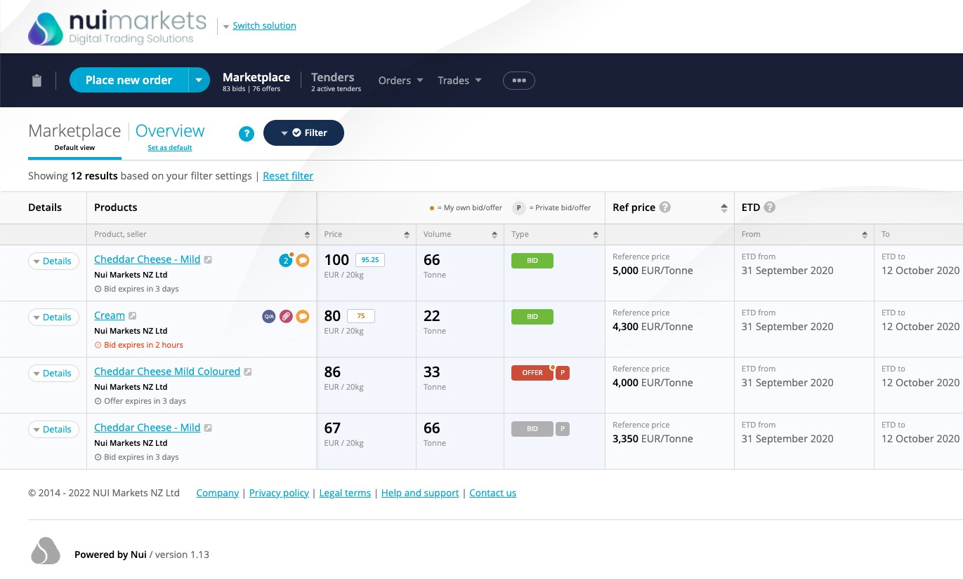
Page 3
Nui 101
Who are we?
Nui Markets is a New Zealand headquartered startup that provides a configurable, co-branded platform for B2B digital trading of agricultural products (food and bioenergy) – both as a single seller digital channel and as a multi seller marketplace. We started as a “platform as a service” business but have since expanded into the role of platform operator for our dairy multi seller platforms.
The platform
What is the problem we are solving?
Traditional sales processes in our target markets are inefficient and non-transparent as they rely on legacy communications and large sales teams. There is no visibility of true market prices and market information is limited. As well as this, the administrative burden of each trade is significant for both buyers and sellers.
How do we solve this problem?
We’ve built a fit-for-purpose proprietary platform for B2B digital trading which our customers and users love. We cover the seller’s workflow from placing an offer and managing auctions, right through to managing post-trade execution and documents, and communicating with buyers. Our platform makes trading more transparent, efficient and profitable for our users.
What’s the Business Model?
Our platform serves two distinct customer groups:
Major processors, as a digital channel to sell to their own customers
Marketplaces who use the Nui platform to operate a co-branded multi seller marketplace, with platform exclusivity granted for a particular region and sector.
We currently have three streams of revenue: implementation fees, subscription charges, and trade commissions. The monetization of platform data has the potential to provide a new revenue stream in the future.
Some of our customers
DRAFT
Nui Markets Pitch Deck - April 2022

Slide 4
Page 4
Global agricultural product trading needs a digital transformation - that’s where we come in
The size of the prize (USD) for food commodity trading
$1.6T
Global traded exports of all food commodities in 2020
Despite living in a time of great technological advances, B2B trading of agricultural products has remained antiquated. Traders rely on personal relationships and are dependent on finding the right buyer, at the right time, at the right price. Typical sales teams communicate directly with customers on a one-to-one basis across many channels such as Whatsapp and email. Agreeing and administering trade is thus labour-intensive and difficult to scale.
Admittedly, COVID-19 has accelerated the uptake of digital solutions for traditional trade. However, existing solutions built on generic frameworks like Magento or Mirakl fail to cater to the complex workflow requirements of B2B export/import of agricultural products.
$800B
Presuming we can serve half
of the industry verticals
As a result, traders suffer from poor price discovery, high costs of searching for trading partners, administrative inefficiencies, pressured margins, and increased counterparty risk when trading with unfamiliar partners.
$4B
Global commissions available presuming a 50% revenue share of a 1% commission
The prize for serving this unmet need is immense. We have only begun to tap into the global opportunity to provide our fit-for-purpose platform to food and bioenergy traders everywhere.
Seafood global market size (USD)
Eggs global market size (USD)
Ethanol global market size (USD)
$200M
Possible Nui revenue obtainable assuming a 5% market share
$113 billion
$198 billion
$89 billion
DRAFT
Nui Markets Pitch Deck - April 2022

Slide 5
Page 5
We’ve built a fit-for-purpose platform for agricultural product trading which our customers and users love
Developing single seller platforms – ‘one-to-many’
Expanding into multi
seller/multi buyer platforms – ‘many-to-many’
3
Expanding into the role of platform operator
1
2
2016
2018
2022 Beyond
Six years ago, we created a “Platform as a Service” business providing white-label platforms for use as private digital channels for single exporters. Soon after, our platforms started to be used by independent marketplace operators to run multi seller/multi buyer digital marketplaces.
More recently, we have stepped into the role of platform operator and have expanded into multi seller/multi buyer platforms in Europe and North America.
We have three forms of income: implementation fees, subscription charges, and trade commissions. The monetization of platform data has the potential to provide a new revenue stream in the future.
Nui platforms provide:
Increased trade efficiency
Improved price transparency
Enriched market info
Expanded market access
Nui platforms streamline the sales process, reducing the time and effort required
for a trade to take place. When you start using a Nui platform, this increased level of efficiency is noticeable right from the
first trade.
Nui platforms make trading less opaque by ensuring that trade occurs at a true market price which is visible to all participants. This ultimately reduces negotiation tension and encourages trade.
Nui platforms take the guesswork out of trade. Analytics dashboards provide detailed, real-time data about prices, volumes, and activity on the platform. This allows our customers to make more informed trading decisions. We are investing heavily in data collection and analysis and in data monetization strategies.
Nui platforms provide an efficient way for sellers to engage with more buyers, more regularly with the same level of resources.
Consequently, sellers can capture more demand whilst buyers have greater access to a wider range of products.
DRAFT
Nui Markets Pitch Deck - April 2022

Slide 6
Page 6
With NZD$808M traded since 2016, we are experiencing exponential growth
As of the end of March 2022, Nui had 307 companies accessing a Nui platform, in 50 countries. In the 12 months to the end of March 2022, over 1,990 trades were completed, totalling 65,730 tonnes with a GMV of over NZD$307m. We have experienced exponential revenue growth, with total revenue in NZD increasing from $0.259m in FY2017 to $0.807m in FY20 and $1.456m in FY21. Revenue in FYTD (July 2021 to March 2022) is $1.767m NZD based on the management accounts.
Since inception (as of end of March 2022) Current users (in 12 months to end of March 2022)
4,138
Trades
200,042
Tonnes traded
$808m
Face value
traded (NZD)
605
Active Users
307
Companies
50
Countries
represented
Key FY2021 metrics:
Total revenue for FY2021
Revenue CAGR for the period FY2017 to FY2021
GMV CAGR for the period FY2017 to FY2021
NZD$1.456 million
53.9%
Improved price transparency
Enriched market info
Expanded market access
61.5%
Note: FY2017 is 1 July 2016 to 30 June 2017
DRAFT
Nui Markets Pitch Deck - April 2022

Slide 7
Page 7
Our success to date is a product of our unique value proposition and competitive advantage
Our competitive advantage:
Name Founded Origin
Our ability to seamlessly white label the platform so it looks and feels like it belongs to our customer
Our clean and intuitive interface that improves customer experience
Our status as industry agnostic – we are not affiliated with any major trader
Our expertise in the sectors we trade in
Our commitment to allowing our customers to set the rules of what, when and with whom they trade
Value proposition
What sets Nui apart
Digital platform
Technology plus human network connecting buyers and sellers globally
Help importers and exporters understand global market of food and agri
Ability to seamlessly make the platform look and feel like it belongs to our customer (branding and language)
Our clean and intuitive interface separates users from the complexity of trade
Live auctions
1.
2015
South Korea
Work with companies around the world to discover the market-based reference prices for dairy
Create new trading opportunities
Toolkit for connecting global pools of buyers and sellers
Data analysis
We stand alone - not affiliated with a major trader (i.e. Fonterra)
Our customers set the rules of what, when and with whom they trade
GDT index effectively sets the price of NZ milk - we have the ability to do that for other markets (US and Europe)
2.
2008
New Zealand
Advanced enterprise marketplace SaaS platform
B2B and B2C
Faster launch
Connects ecosystems
Industry knowledge of the sectors we trade in
Live auctions
3.
2011
France
4.
2014
USA
Finance (factoring)
Wide array of payment solutions
Partner to growers
Sector agnostic
Live auctions
DRAFT
Nui Markets Pitch Deck - April 2022

Slide 8
Page 8
How Nui has enabled Hilmar Cheese to realise the benefits of digital trading
The challenge
Hilmar Cheese Company was looking for a way to sell the off-spec products in their “Opportunity Cheese Division,” while maximizing price achievement.
Partnering with Nui
Hilmar wanted to improve their inefficient sales process, which involved countless phone calls and emails, by tapping into the benefits of digital trading.
Initially, Hilmar considered building their own platform, but quickly realized this would require an outsized investment both in terms of time and money, so instead they identified Nui as a partner.
Hilmar provided Nui with an understanding of their requirements and within weeks Hilmar had a working single seller platform with all the features needed to trade their off-spec products digitally.
On HilmarConnectTM (as of end of March 2022)
The platform
The new digital platform – HilmarConnectTM– quickly established itself as a success. Sales exceeded initial expectations and their customers were energized by the new buying option.
For over a year, Hilmar have run weekly auctions on the platform with all of their off-spec offerings. In February 2022, they started to also sell some of their first-grade products through auctions on the platform.
Additionally, Hilmar has had success using the platform’s open marketplace function. The marketplace provides a space for both Hilmar and their customers to place bids and offers on approved products. This allows Hilmar to quickly get a sense as to what a given product is worth to their customers.
Outcomes
Utilizing Nui’s open marketplace and live auction functions, Hilmar has enjoyed the following key benefits:
Price discovery and achievement
Transactional transparency Round the clock availability
Access to a broader customer base
“The introduction of HilmarConnect™ has revolutionized our sales process. Our customers now have far greater access to our products and know that they are paying the true market price for our products at any point in time.”
Travis Coffey, Director - Cheese Sales
Improved price transparency
Enriched market info
Expanded market access
28,778
Tonnes traded
$125m
Face value
traded (NZD)
1,352
Trades
Increased trade efficiency
DRAFT
Nui Markets Pitch Deck - April 2022

Slide 9
The next chapter in our journey
Page 9
Nui aims to become an industry leader in B2B digital trading of agricultural products through embracing three key paths to growth.
DRAFT
Nui Markets Pitch Deck - April 2022

Slide 10
Expanding our “platform as a service” offering in existing and new verticals
Page 10
1
Double-down on dairy
Further expand in North America
Standing up further single seller platforms in the US Dairy Market.
Build an Asian buyer base
Identifying dairy buyers in Asia and introducing them to our international platforms will increase the volume traded.
We will engage in-market agents in South-East Asia to drive liquidity.
Shorten sales cycle process
Although each sales cycle differs, our experience in the dairy sector has allowed us to shorten the sales cycle to a target of 12 weeks.
Expand in ethanol in Brazil
We will use our experience in digital trading to build out a strong online trading ecosystem for ethanol.
A year-long opportunity validation exercise has allowed us to confirm that there is a strong business case to proceed with this.
We are already working with our partner in Brazil on a phased implementation plan.
Trading through the platform will improve trade efficiency for all partners and bring with it the market transparency that all parties seek.
We are aiming to launch the ethanol platform in July 2022.
Explore new sectors
Pilot customers in produce, meat and now ethanol confirm to us that the Nui platform can be effective in many sectors.
We do recognise, however, that to succeed, we need the right partners and a strong knowledge of the sector.
We want to focus in on markets with a large spot market and a large number of buyers and sellers.
A discovery phase will be undertaken in a number of sectors to further determine fit - sectors recently identified include eggs, fertiliser, animal feed, carbon and biofuel.
Alongside this, we remain opportunistic and will consider further pilot customers where practical.
2022
July 2022 - end of 2023
From January 2023
DRAFT
Nui Markets Pitch Deck - April 2022

Slide 11
Becoming the platform operator of choice in dairy
Since 2018, Nui has provided a multi seller/multi buyer platform to Dairy Auctions Online (DAO). We have now expanded into the role of platform operator – firstly with DAO and then with Nui Markets North America.
Page 11
2
Benefits of Nui becoming the platform operator on our multi seller/multi buyer platforms:
Increased trust in the platforms as Nui is industry agnostic and does not trade on the platforms.
Nui gains a clearer view of customer needs as we are closer to end users. Our overall industry knowledge increases.
Nui receives 100% of revenue from the platforms.
Nui can upsell customers, starting them off on a multi seller/multi buyer platform before offering them the option to have their own single seller platform once they are familiar with the technology.
The platforms can be Nui-branded, allowing us to grow brand awareness.
We can increase our offering to current customers as we are able to facilitate buyers moving from one of our multi seller/multi buyer platforms to one of our single seller platforms.
We can share market insights from multi seller/multi buyer platforms as appropriate
DAO was owned and operated by a prominent European dairy trader. Because this trader also traded on the platform, there was a misguided unwillingness by competing traders to use the platform and risk advantaging their competitor.
To combat this issue, we have acquired DAO, which has made the platform independent of any market participant.
Since 1 April, we have been platform operator with full control over the platform. We will rebrand it ‘Nui Markets Europe’ later this year.
Since the announcement of the acquisition of DAO on 10 February, 10 companies have reactivated their account and 6 new companies have joined the platform.
At the end of April, 95 companies were members of the DAO platform.
In April 2022, we launched Nui Markets North America, our second multi seller/multi buyer platform with Nui as the platform operator.
This platform expands Nui’s presence in the North American Dairy Market, where we already provide single seller platforms.
DRAFT
Nui Markets Pitch Deck - April 2022

Slide 12
Enhancing platform features to drive revenue growth
Our third path to growth will see us developing new features to drive an increase in trade volume.
Page 12
3
Increasing flexibility of trade
Targeted offers and promotions
Expand trade functionality to enable trading outside of spot market
Focus on flexibility in order formats
Further improving trade efficiency
Options for payments, factoring, or credit insurance
Freight/logistics
Integrated flow of data in and out
Customer insights to strengthen sales process
Trade insights to highlight areas to improve or target
We will increase trade volume on Nui platforms through:
Supporting our customers’ business initiatives
Enable and reward sustainable practice
Track and trace
Production of a comprehensive data package to support our customers’ growth
Boosting user engagement
Insights through analytics dashboards which provide detailed, real-time data
Vital information right at your fingertips to give our customers critical knowledge
Increased connectivity between buyers, sellers and Nui
DRAFT
Nui Markets Pitch Deck - April 2022

Slide 13
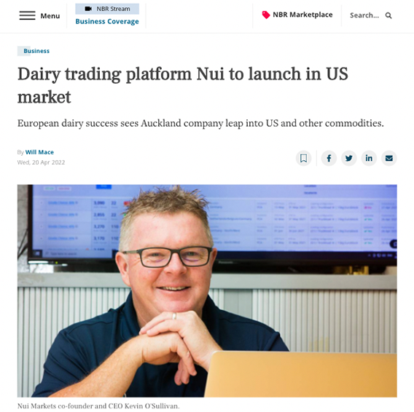
Page 13
We’re raising a 10m USD round at a pre-money valuation of 50m USD
In 2021, a bridging round of 3.3m NZD was raised which enabled us to continue our expansion, acquire DAO, and further expand the development of ethanol in Brazil.
We are now looking for professional investors with a strong track history of supporting international market expansion.
Use of funds – June 2024 runway
Improve the product
Develop new verticals
Expand current markets and operate marketplaces
Marketing and buyer acquisition
2.6%
7%
33.0%
Further expand our technical footprint to deliver on our roadmap
42.1%
Enriched market info
Identify, build and develop service offering in new verticals
Scale Nui Markets Europe and refresh brand positioning
Develop and scale Nui Markets North America
Finalise our Ethanol trading platform
Improved price transparency
Enriched market info
63%
13.7%
8.6%
Expand team to support growth in current markets
Establish first in class platform operation services
Develop and deliver ESG plan
Increased trade efficiency
Expand in Asia to develop a strong buyer base
Monthly marketing promotions
Develop Nui global marketing and communications footprint
DRAFT
Nui Markets Pitch Deck - April 2022

Slide 14
This investment will enable us to achieve a projected seven-fold increase in revenue by 2025
Page 14
Revenue growth will come from the acquisition of new customers, the acquisition of DAO Europe, the establishment of a multi seller platform for US dairy and the launch of a platform for ethanol in Brazil. This investment will enable us to achieve the scale necessary to drive growth.
Improved price transparency
Enriched market info
We anticipate a seven-fold growth in revenue
from FY 2021 to FY 2025
Note¹: Up until FY21, Revenue is based on the Financial Statements. FY21 included the application of Accounting Revenue Recognition requirements. From FY22 onwards revenue is based on the management accounts, pure revenue which excludes the application of Accounting Revenue Recognition.
Note²: For Net Cash, assumed $10m USD investment in August 2022. Balance of net cash as at June each year.
Note³: 1-year average rate of 1 NZD : 0.7070 USD has been used.
Increased trade efficiency
Exit
This Series A capital raise will provide us with a 22-month runway until the end of June 2024. At that time, our likely scenario will be to raise under a Series B and prepare for an exit in 2027/28.
Annual Recurring Revenue (ARR) as a percentage of Annual Total Revenue
FY21 | FY22 | FY23 | FY24 | FY25
69% | 85% | 89% | 90% | 91%
DRAFT
Nui Markets Pitch Deck - April 2022

Slide 15
A team of experienced experts in technology, trading and sales
Page 15
Kevin O’Sullivan - Founder and CEO
“We targeted dairy as our first vertical as we had experience and knowledge in the sector and could see growth in volumes. Volume growth was driven by increasing demand and the increasingly wealthy Asian market. Added to that was the decision from the EU to remove production caps for dairy production, which had been in place since 1984.
Jeppe R.S. Joeker - Europe - Lead
Jeppe is heading up Nui's presence in Europe. Jeppe is a strong sales professional with extensive knowledge of the European dairy trade industry and expertise in sales, logistics and primary industries. Before joining Nui, Jeppe was a key accounts manager at Arla agriculturals, where he played an important role in developing and implementing the Arla Cheese online trading platform.
Jonathan Spurway - Americas - Lead
Jonathan is based in Seattle, Washington and is the head of Sales for Nui North America. Jonathan has more than 17 years of experience in the agricultural and value-added ingredients sector. From Auckland, New Zealand, he started his career in the Dairy industry, working for Fonterra Group Cooperative. While at Fonterra, Jonathan worked across the globe in technical and commercial capacities, spending time in the Americas, North Asia, China, Southeast Asia and Europe.
Governance
The Board of Nui Markets is made up of founding investors, with Mike Petersen as the Independent Chair. Nui’s directors and advisors have extensive experience in the global agribusiness sector which has lent them a deep understanding of the role of technology in enhancing international trade. These strategic and governance insights draw on the valuable experience of people involved with various companies, including Global Dairy Trade (GDT), KPMG and Open Country Cheese.
As Chair, Mike has a strong background in international trade and markets having served as New Zealand’s Special Agricultural Trade Envoy for 6 years alongside his other commercial governance roles with ANZCO Foods and several large agribusinesses. Mike has also worked as an advisor to a number of NZX listed companies involved with carbon forestry farming.
It is anticipated that with the growth of Nui and the success of the Series A round, the board of Nui Markets will continue to evolve by strengthening the range of skills, knowledge and experience that will be required for a rapidly growing, international, digital business.
A growing company
In 2022, to meet the needs of the business as it grows, we will expand the technical team, establish teams for DAO in Europe and the multi seller in the US, and engage in-market agents in Asia. Beyond this, we will bring on resources to support expansion into new sectors and separate operational and change responsibility to enable the right levels of support. In the next 2-3 years, we plan to recruit more than 30 people.
Dr. Vladimir Managarov, PhD - Chief Technology Officer
Vladimir specialises in creating complex web solutions to successfully fulfil business needs. He brings a clear view of time and resource allocation strategies. He has extensive experience in Europe and New Zealand, and prior to joining Nui held a number of senior development roles with Yellow New Zealand, Evanti and Raduga Internet.
Rebecca Swinson - Chief of Customer, Product and Delivery
Rebecca works closely with customers and our technical team to define and deliver platform improvements to meet the varying needs of our customers. Prior to joining Nui, Rebecca led business transformation initiatives for a number of large organisations across multiple sectors including finance, electricity, telecoms and FMCG.
Enriched market info
Improved price transparency
Ashley Honey - Markets Expansion, Americas
Ashley has more than 15 years' experience in commodities, foreign exchange trading and treasury risk management. Armed with this experience, Ashley has been able to become very knowledgeable on the Ethanol markets in Brazil and the opportunity it presents.
Increased trade efficiency
DRAFT
Nui Markets Pitch Deck - April 2022

Slide 16
A selection of our customers
Page 16
DRAFT
Nui Markets Pitch Deck - April 2022

