Slide 1

Investor Pitch Deck - April 2022
Simplifying the world of commodity trading with our
efficient, transparent, and digital trade platform.
DRAFT

Slide 2

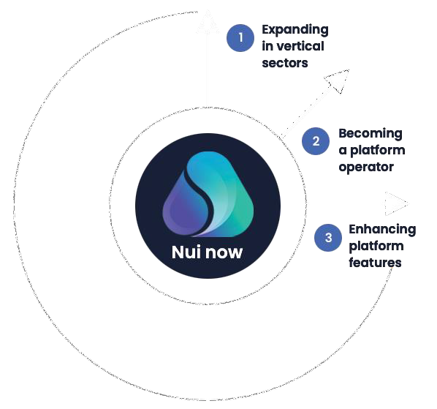
Summary
The next chapter
Nui aims to become an industry leader in commodity trading through embracing three key paths to growth.
The timing is right to expand. We are looking for a growth capital partner to join our journey.
Nui Markets (Nui) provides a configurable, co-branded platform for agricultural commodity trading – both as a single seller digital channel and as a multi seller marketplace. This platform is used by 287 companies in 47 countries. Since inception in 2016, NZD$755m of GMV has been traded through our platform. We have identified an opportunity to rapidly expand and consolidate our platform globally. We are now seeking 10m USD of equity capital.
This growth capital will enable us to become an industry leader in commodity trading through embracing three key paths to growth:
Expand our “platform as a service” offering in new verticals Become a platform operator in our chosen dairy markets
Enhance platform features to add more value to our users’ trading
Nui is beginning to experience exponential growth – with 62% annual growth in GMV and almost 200% annual growth in the number of trades through a Nui platform in 2021. By receiving the funding that we need to truly scale our offering, we forecast a 7 times increase in revenue growth over the next four years.
In the last year, we have focused on fine-tuning our core offering of efficient and intuitive online trade. Our flexible model and broad range of trade features enables any agricultural commodity trader or exporter, anywhere in the world, to join our ecosystem and trade conveniently.
We have a proven product and a scalable platform. The adoption of digital trading within agricultural commodity markets has meant that we are at the right place, at the right time to become a category leader. Nui, in Maori means ‘big’, ‘great’ or ‘abundance’ - those words adequately convey our ambition to be the largest global agricultural commodity trading platform.
Nui Markets Pitch Deck - April 2022
DRAFT

Slide 3

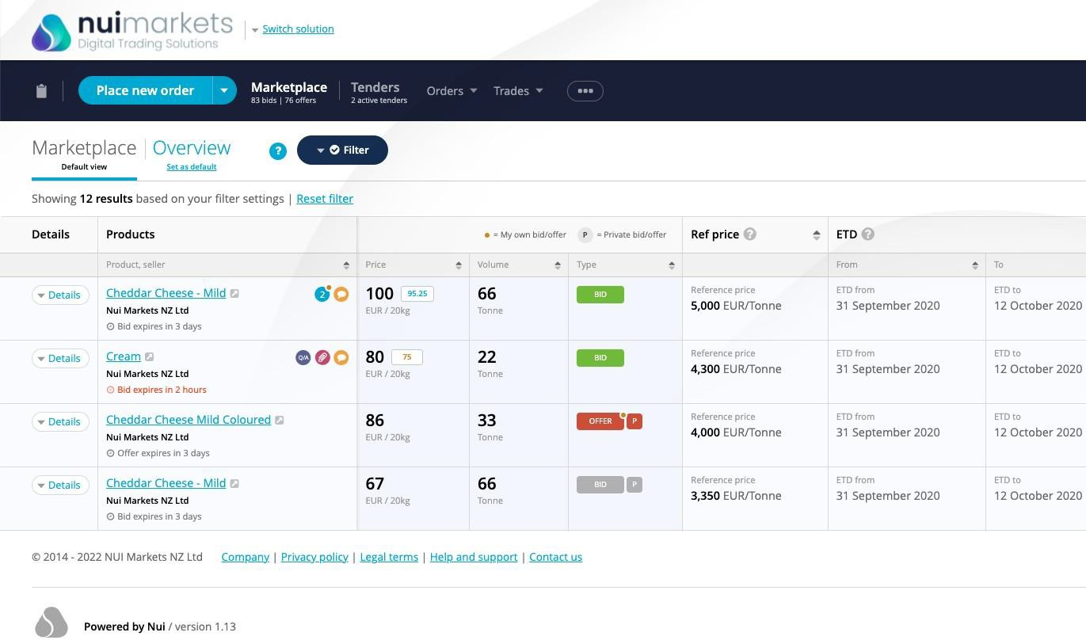





Nui 101
Who are we?
Nui Markets is a New Zealand headquartered startup that provides a configurable, co-branded platform for agricultural commodity trading – both as a single seller digital channel and as a multi seller marketplace. We started as a “platform as a service” business but have since expanded into the role of platform operator for our dairy multi seller platforms.
What is the problem we are solving?
Traditional sales processes for agricultural commodities are inefficient and non-transparent as they rely on legacy comms and large sales teams. There is no visibility of true market prices and market information is limited. As well as this, the administrative burden of each trade is significant for both buyers and sellers.
How do we solve this problem?
We’ve built a fit-for-purpose proprietary platform for agricultural commodity trading which our customers and users love. We cover the seller’s workflow from placing an offer and managing tenders, right through to managing post-trade execution and documents, and communicating with buyers. Our platform makes trading more transparent, efficient and profitable for our users.
What’s the Business Model?
Our platform serves two distinct customer groups:
Major exporters, as a digital channel to sell to their own customers
Marketplaces who use the Nui platform to operate a co-branded multi-seller marketplace, with platform exclusivity granted for a particular region and commodity.
We have three streams of revenue: implementation fees, subscription
charges, and trade commissions.
The platform
Some of our customers
DRAFT

Slide 4
Global commodity trading needs a digital transformation - that’s where we come in
The size of the prize ($USD) for
food commodity trading
Despite living in a time of great technological advances, the way agricultural commodities are physically traded on the spot market has remained antiquated. Traders rely on personal relationships and are dependent on finding the right buyer, at the right time, at the right price. Typical sales teams communicate directly with customers on a one-to- one basis across many channels such as Whatsapp and email. Agreeing and administering trade of agricultural commodities is thus labour-intensive and difficult to scale.
$1.6T
Global traded exports of all food commodities in 2020
$800B
Presuming we can serve half
of the industry verticals
Admittedly, COVID-19 has accelerated the uptake of digital solutions for traditional trade. However, existing solutions built on generic frameworks like Magento or Mirakl fail to cater to the complex workflow requirements of agricultural commodity export/import.
As a result, traders suffer from poor price discovery, high costs of searching for trading partners, administrative inefficiencies, pressured margins, and increased counterparty risk when trading with unfamiliar partners.
$4B
Global commissions available presuming a 50% revenue share of a 1% commission
The prize for serving this unmet need is immense. We have only begun to tap into the global opportunity to provide our fit-for-purpose platform to commodity traders everywhere.
Fish Global trading
market
Eggs Global trading
market
Ethanol Global trading
market
$200M
Possible Nui revenue obtainable assuming a 5% market share
$401 billion
$108 billion
$141 billion

Slide 5




We’ve built a fit-for-purpose platform for commodity
trading which our customers and users love
1
Developing single seller platforms – ‘one-to-many’
2
Expanding into multi seller/multi buyer platforms – ‘many-to-many’
2018
3
Expanding into the role of platform operator
2022 Beyond
2016
Six years ago, we created a “Platform as a Service” business providing white-label platforms for use as private digital channels for single exporters. Soon after, our platforms started to be used by independent marketplace operators to run multi seller/multi buyer digital marketplaces.
We are stepping into the role of platform operator and will expand our multi seller/multi buyer platforms in Europe and
North America.
We have three forms of income: implementation fees, subscription charges, and trade commissions.
Nui platforms provide:
Increased trade efficiency
Improved price transparency
Enriched market info
Expanded market access
Nui platforms streamline the sales process, reducing the time and effort required
for a trade to take place. When you start using a Nui platform,
this increased level of efficiency
is noticeable right from the first trade.
Nui platforms make trading less opaque through ensuring that trade occurs at a true market price which is visible to all participants. This ultimately reduces negotiation tension and encourages trade.
Nui platforms take the guesswork out of pricing new products. Sellers can ‘test the waters’ with open price offers and accurately gauge the level of market demand.
Nui platforms provide an efficient way for sellers to engage with more buyers, more regularly with the same level of resources.
Consequently, sellers can capture more demand whilst buyers have greater access to a wider range of products.

Slide 6
With NZ$755M traded since 2016, we are starting to experience
exponential growth
As of the end of February 2022, Nui had over 287 companies accessing a Nui platform, in 47 countries. In the 12 months to the end of Feb 2022, over 1,860 trades, totalling 65,188 tonnes with a GMV of over NZD$282m. We have experienced exponential revenue growth, with total revenue in NZD increasing from $0.259m in FY2017 to $0.807m in FY20 and $1.456m in FY21.
Since inception (as of end of Feb 2022)
Current users (in 12 months to end of Feb 2022)
3,882
Trades
192,000
Tonnes traded
$755m
Face value
traded (NZD)
1,140
Users
287
Companies
47
Countries
represented
Key FY2021 metrics:
Total revenue for FY2021
Number of trades per annum since inception
NZ$1.456
million
1800
1600
1400
1200
1000
800
600
400
200
0
Revenue CAGR for the
period FY2017 to FY2021
53.9%
GMV CAGR for the
period FY2017 to
61.5%
FY2021
Note: FY2017 is 1 July 2016 to 30 June 2017
2016
2017
2018
2019
2020
2021

Slide 7
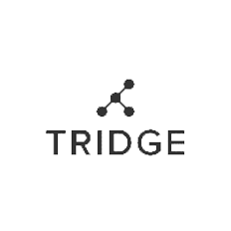



Our success to date is a product of our unique value proposition and competitive advantage
Our competitive advantage:
Our ability to seamlessly white label the platform so it looks and feels like it belongs to our customer
Our clean and intuitive interface that improves customer experience
Our status as industry agnostic – we are not affiliated with any major trader
Our expertise in commodity trading
Our commitment to allowing our customers to set the rules of what, when and with whom they trade
Name
Founded
Origin
Value proposition
What sets Nui apart
Digital platform
Technology plus human network
connecting buyers and sellers globally
Help importers and exporters understand global market of food and agri
Ability to seemlessly make the platform look and feel it belongs to our customer (branding and language)
Our clean and intuitive interface separates users from the complexity of trade
Live auctions
1.
2015
South
Korea
Work with companies around the world to discover the market-based reference prices for dairy
Create new trading opportunities
Toolkit for connecting global pools of buyers and sellers
Data analysis
We stand alone - not affiliated with a major trader (i.e. Fonterra)
Our customers set the rules of what, when and with whom they trade
GDT index effectively sets the price of NZ
milk - we have the ability to do that for other markets (US and Europe)
2.
2008
New
Zealand
Advanced enterprise marketplace SaaS
platform
B2B and B2C
Faster launch
Connects ecosystems
Industry expertise and knowledge of
commodity trading
3.
2011
France
2014
USA
Finance (factoring)
Wide array of payment solutions
Partner to growers
Sector agnostic
Live auctions
4.
DRAFT
Nui Markets Pitch Deck - April 2022

Slide 8

How Nui has enabled Hilmar Cheese to realise the
benefits of digital trading
The challenge
Hilmar Cheese Company was looking for a way to sell the off- spec products in their “Opportunity Cheese Division,” while maximizing price achievement.
Partnering with Nui
Hilmar wanted to improve their inefficient sales process, which involved countless phone calls and emails, by tapping into the benefits of digital trading.
Initially, Hilmar considered building their own platform, but quickly realized this would require an outsized investment both in terms of time and money, so instead they identified Nui as a partner.
Hilmar provided Nui with an understanding of their requirements and within weeks Hilmar had a working single seller platform with all the features needed to trade their off-spec products digitally.
The platform
The new digital platform – HilmarConnectTM– quickly established itself as a success. Sales exceeded initial expectations and their customers were energized by the new buying option.
For over a year, Hilmar have run weekly auctions on the platform with all of their off-spec offerings. In February 2022, they started to also sell some of their first-grade products through auctions on the platform.
Additionally, Hilmar has had success using the platform’s open marketplace function. The marketplace provides a space for both Hilmar and their customers to place bids and offers on approved products. This allows Hilmar to quickly get a sense as to what a given product is worth to their customers.
Outcomes
Utilizing Nui’s open marketplace and live auction functions, Hilmar has enjoyed the following key benefits:
Price discovery and achievement
Transactional transparency Round the clock availability
Access to a broader customer base
“The introduction of HilmarConnect™ has revolutionized our sales process. Our customers now have far greater access to our products and know that they are paying the true market price for our products at any point in time.”
On HilmarConnectTM (as of end of Feb 2022)
1,213
Trades
26,034
Tonnes
traded
$111M
Face value
traded (NZD)
Travis Coffey, Director - Cheese Sales
DRAFT

Slide 9

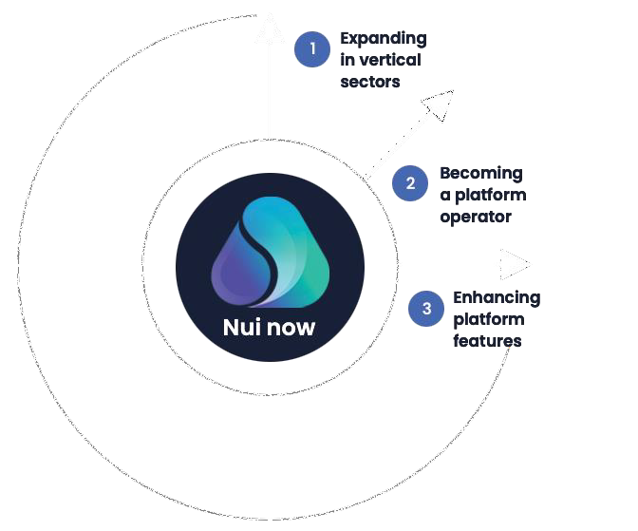
The next chapter in our journey
Nui aims to become an industry leader in commodity trading through embracing three key paths to growth.

Slide 10
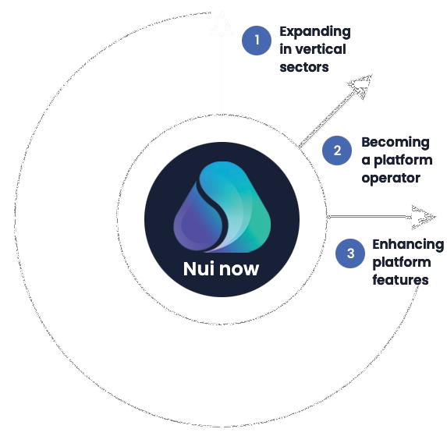
Expanding our “platform as a service” offering in existing and
new verticals
1
Double-down on dairy
Build an Asian buyer base
Identifying dairy buyers in Asia and introducing them to our international platforms will increase the volume traded.
We will engage in-market agents in South-East Asia to drive liquidity.
Further expand multi seller/multi buyer platform operated model
We will create a multi seller/multi buyer dairy platform operated model in North America during Q2 2022.
Sales cycle process
Although each sales cycle differs, our experience in the dairy sector has allowed us to shorten the sales cycle to a target of 12 weeks.
Expand in ethanol in Brazil
We will use our experience in dairy and other sectors to build out a strong online trading ecosystem for ethanol.
A year-long discovery exercise has allowed us to confirm that there is a strong business case to proceed with this.
Once commercials are in place, we’ll work with our partner in Brazil on a detailed implementation plan including user
set-up and training.
Trading through the platform will improve trade efficiency for all partners and bring with it the market transparency that all parties seek.
We are aiming to launch the ethanol platform in July 2022.
Explore new sectors
Pilot customers in produce, meat and now ethanol confirm to us that the Nui platform can be effective in many sectors.
We do recognise, however, that to succeed, we need the right partners and a strong knowledge of the sector.
We want to focus in on true commodity markets with a large spot market and a large number of buyers and sellers.
A discovery phase will be undertaken in a number of sectors to further determine fit - sectors recently identified include eggs, fertiliser, animal feed, carbon and biofuel.
Alongside this, we remain opportunistic and will consider further pilot customers where practical.
2022
July 2022 - end of 2023
From January 2023

Slide 11
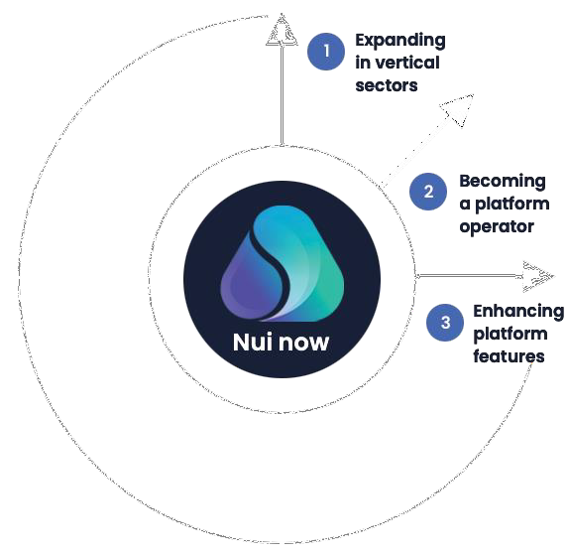


Becoming a platform operator
2
Since 2018, Nui has provided a multi seller/multi buyer platform to Dairy Auctions Online (DAO). We are now
expanding into the role of platform operator – firstly with DAO and then with Nui Markets North America.
DAO was owned and operated by a prominent European dairy trader. Because this trader also traded on the platform, there was a misguided unwillingness by competing traders to use the platform and risk advantaging their competitor.
To combat this issue, we have acquired DAO, which will make the platform independent of any market participant.
Since 1 April, we have been platform operator with full control over the platform. We will rebrand it ‘Nui Markets Europe’ later this year.
Since the announcement of the acquisition of DAO, which will make it industry agnostic and independent, we have 5 historical companies that reactivated their account and 4 new companies that joined the platform.
This gives a total of 95 companies trading on DAO.
Benefits of Nui becoming the platform operator on our multi seller/multi buyer platforms:
Increased trust in the platforms as Nui is industry agnostic and does not trade on the platforms.
Nui gains a clearer view of customer needs as we are closer to end users. Our overall industry knowledge increases.
Nui receives 100% of revenue from the platforms.
Nui can upsell customers, starting them off on a multi seller/multi buyer platform before offering them the option to have their own single seller platform once they are familiar with the technology.
The platforms can be Nui-branded, allowing us to grow brand awareness.
We can increase our offering to current customers as we are able to facilitate buyers moving from one of our multi seller/multi buyer platforms to one of our single seller platforms.
In April 2022, we will launch Nui Markets North America, our second multi seller/multi buyer platform. Nui will be the platform operator.
This will expand Nui’s presence in the North American Dairy Market, where we already provide single seller platforms.

Slide 12










Enhancing platform features to drive revenue growth
3
Our third path to growth will see us developing new features to drive an increase in trade volume.
Increasing flexibility of trade
Targeted offers and promotions
Expand trade functionality to enable
trading outside of spot market
Focus on flexibility in order formats
Further improving trade
efficiency
Options for payments, factoring, or credit insurance
Freight/logistics
Integrated flow of
data in and out
Customer insights to strengthen sales process
Trade insights to highlight areas to improve or target
We will increase trade volume on Nui platforms through:
Supporting our customers’ business initiatives
Enable and reward sustainable practice
Track and trace
Boosting user engagement
Insights through
analytics
Vital information right
at your fingertips
Increased connectivity
between buyers, sellers
and Nui

Slide 13





Capital Raise $10m USD
In 2021, a bridging round of 2.5m NZD was raised which enabled us to continue our expansion, acquire DAO, and further expand the development of ethanol in Brazil.
We are now looking for European professional investors with a strong track history of supporting international market expansion.
Use of funds - 24-month runway
7%
19%
Improve the product
Further expand our technical footprint to deliver on our roadmap
16%
Develop new verticals
Identify, build and develop service offering in new verticals
Scale Nui Markets Europe and refresh brand positioning
Develop and scale Nui Markets North America
Finalise our Ethanol trading platform
Consolidate and expand existing operations for 24 months
(to September 2024)
59%
Expand current markets and
operate marketplaces
Marketing and buyer acquisition
Expand in Asia to develop a strong buyer base
Monthly marketing promotions
Develop Nui global marketing and comms footprint
• Develop ESG plan

Slide 14





This investment will enable us to achieve a projected seven-fold increase in revenue by 2025
Revenue growth will come from the acquisition of new customers, the acquisition of DAO Europe, the establishment of a multi seller platform for US dairy and the launch of a platform for ethanol in Brazil. This investment will enable us to achieve the scale necessary to drive growth.
Revenue¹, EBITDA and net cash² forecast
FY2025 revenue forecast - composition
Ethanol,
12
Forecast
$1,380,934
10
Growth in Existing Customers,
$4,436,693
8
6
Millions NZD
4
Nui Markets North America,
$2,817,539
2
0
-2
FY18
FY19
FY20
FY21
FY22
FY23
FY24
FY25
New Customers,
$890,000
DAO EU,
$699,633
-4
-6
We anticipate a seven-fold growth in revenue
from FY 2021 to FY 2025
Revenue EBITDA Net Cash
Note¹: Up to FY21, Revenue is based on Financial Statements applying Accounting Revenue Recognition requirements. For FY22 onwards we are using management account revenue which is pure revenue not applying Accounting Revenue Recognition.
Note²: For Net Cash, assumed $10m NZD investment in August 2022. Balance of net cash as at June each year.
Annual Recurring Revenue (ARR) as a percentage of Annual Total Revenue
Exit
This Series A capital raise will provide us with a 24-month runway until September 2024. At that time, our likely scenario will
FY21 | FY22 | FY23 | FY24 | FY25
69% | 85% | 89% | 90% | 91%
be to raise under a Series B and prepare for an exit in 2027/28.

Slide 15






A team of experienced experts in technology and trading
Kevin O’Sullivan - Founder and CEO
“We targeted dairy as our first vertical as we had experience and knowledge in the sector and could see growth in volumes. Volume growth was driven by increasing demand and the increasingly wealthy Asian market. Added to that was the decision from the EU to remove production caps for dairy production, which had been in place since 1984.
Jeppe R.S. Joeker - Europe - Lead
Jeppe is heading up Nui's presence in Europe. Jeppe is a strong sales professional with extensive knowledge of the European dairy trade industry and expertise in sales, logistics and primary industries. Before joining Nui, Jeppe was a key accounts manager at Arla agriculturals, where he played an important role in developing and implementing the Arla Cheese online trading platform.
Jonathan Spurway - Americas - Lead
Jonathan is based in Seattle, Washington and is the head of Sales for Nui North America. Jonathan has more than 17 years of experience in the agricultural and value-added ingredients sector. From Auckland, New Zealand, he started his career in the Dairy industry, working for Fonterra Group Cooperative. While at Fonterra, Jonathan worked across the globe in technical and commercial capacities, spending time in the Americas, North Asia, China, Southeast Asia and Europe.
Governance
Nui’s Board combines extensive experience in the global agribusiness sector with a deep understanding of the role of technology in enhancing international trade. Industry leaders from the likes of Fonterra’s Global Dairy Trade, KPMG, and Open Country Cheese all make valuable contributions to the governance of Nui.
A growing company
In 2022, to meet the needs of the business as it grows, we will expand the technical team, establish teams for DAO in Europe a n d the multi seller in the US, and engage in- market agents in Asia. Beyond this, we will bring on resources to support expansion into new sectors and separate operational a n d change responsibility to enable the right levels of support. In the next 2-3 years, we plan to recruit more than 30 people.
Dr. Vladimir Managarov, PhD - Chief Technology Officer
Vladimir specialises in creating complex web solutions to successfully fulfil business needs. He brings a clear view of time and resource allocation strategies. He has extensive experience in Europe and New Zealand, and prior to joining Nui held a number of senior development roles with Yellow New Zealand, Evanti and Raduga Internet.
Rebecca Swinson - Chief of Customer, Product and Delivery
Rebecca works closely with customers and our technical team to define and deliver platform improvements to meet the varying needs of our customers. Prior to joining Nui, Rebecca led business transformation initiatives for a number of large organisations across multiple sectors including finance, electricity, telecoms and FMCG.
Ashley Honey - Markets Expansion, Americas
Ashley has more than 15 years' experience in commodities, foreign exchange trading and treasury risk management. Armed with this experience, Ashley has been able to become very knowledgeable on the Ethanol markets in Brazil and the opportunity it presents.

Slide 16
A selection of our customers

