Slide 1
Investor Pitch Deck – March 2022
Transforming global commodity markets with our efficient, transparent, and digital trade platform.
DRAFT

Slide 2
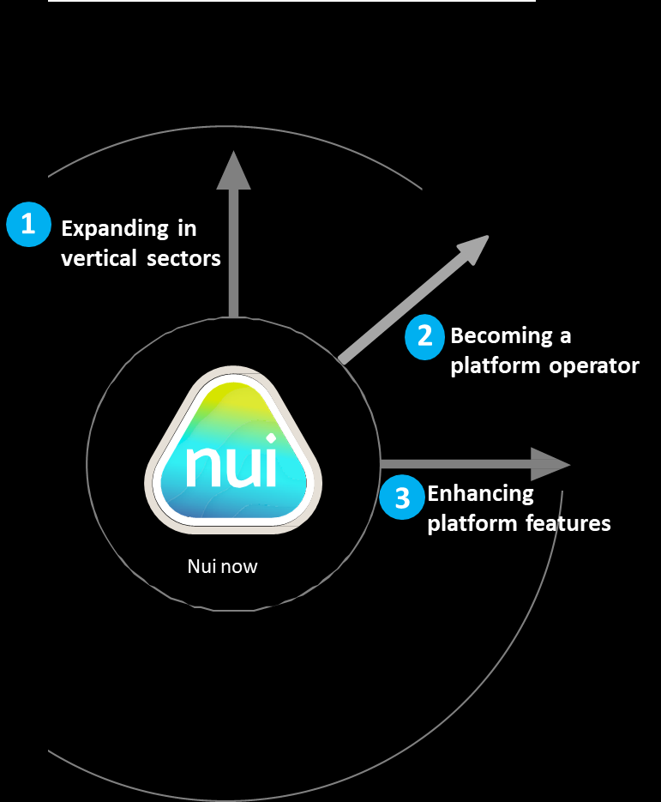
Summary
The timing is right to seize the opportunity to expand. We are looking for a growth capital partner to join our journey.
The next chapter
Nui aims to become an industry leader in commodity trading through embracing three key paths to growth.
Nui Markets provides a fit-for-purpose co-branded platform for agricultural commodity trading – both as a single seller digital channel and as a multi seller marketplace. This platform is used by 287 companies in 47 countries. Since inception in 2016, NZD$755M of GMV has been traded through our platform. We have identified an opportunity to rapidly expand and consolidate our platform globally. We are now seeking 8m EUR of equity capital at a 30m EUR pre-money valuation.
This growth capital will enable us to become an industry leader in commodity trading through embracing three key paths to growth:
Nui is beginning to experience exponential growth – with 122% annual revenue growth in 2021 and almost 300% in trade volume. By receiving the funding we need to truly scale our offering, we forecast a 7 times increase in revenue growth over the next four years.
In the last year we have focused on fine-tuning our core offering of efficient & intuitive online trade. Our flexible model & broad range of trade features enables any agricultural commodity trader or exporter, anywhere in the world, to join our ecosystem and trade conveniently.
We have a proven product and a scalable platform. The rapid adoption of digital trading within agricultural commodity trading has meant that we are at the right place, at the right time to become a category leader. Nui, in Maori means ‘big’, ‘great’ or ‘abundance’ - those words adequately convey our ambition to be the largest global agricultural commodity trading platform.
Grow our “platform as a service” offering in new verticals
Become a marketplace operator in our chosen dairy markets
Enhance platform features to add more value to our users’ trading
DRAFT
Page 2

Slide 3
Global commodity trading needs an upgrade
– that’s where we come in.
The size of the prize ($USD)
Despite living in a time of great technological advances, the way agricultural commodities are physically traded on the spot market has remained antiquated. Traders rely on personal relationships and are dependent on finding the right buyer at the right time, at the right price. Typical sales teams communicate directly with customers on a one-to-one basis across many channels such as Whatsapp and email. Agreeing and administering trade of agricultural commodities is thus labour intensive and difficult to scale.
Admittedly, COVID-19 has accelerated the uptake of digital solutions for traditional trade. However, existing solutions built on generic frameworks like Magento or Mirakl fail to cater to the complex workflow requirements of agricultural commodity export/import.
As a result, traders suffer from poor price discovery, high costs of searching for trading partners, administrative inefficiencies, pressured margins, and increased counterparty risk when trading with unfamiliar partners.
The prize for serving this unmet need is immense. We have only begun to tap into the global opportunity to provide our fit-for-purpose platform to agricultural commodity traders everywhere.
$1.6T
Global traded exports of all food
commodities in 2020
$800B
Presuming we can serve half of the
industry verticals
$4B
Global commissions available presuming a 50% revenue share of a 1% commission
Fish Global trading market
$401 billion
Eggs Global trading market
$108 billion
Ethanol Global trading market
$141 billion
$200M
Possible Nui revenue obtainable
assuming a 5% market share
DRAFT
Page 3

Slide 4
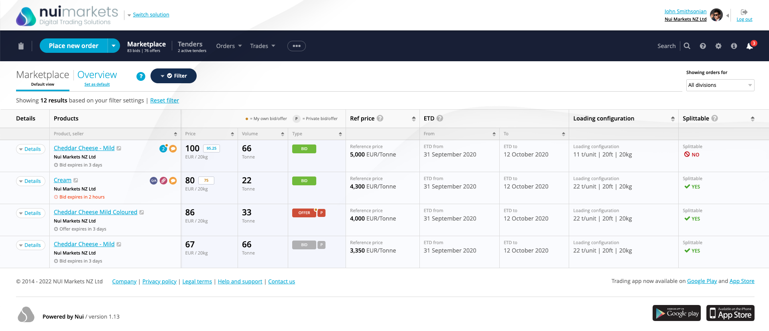
We’ve built a fit-for-purpose platform for agricultural commodity trading which our customers and users love.
Six years ago, we created a “Platform as a Service” business providing white-label platforms for use as private digital channels for single exporters. Soon after, our platforms started to be used by independent marketplace operators to run multi seller digital marketplaces.
We are now expanding into the role of platform operator and will control and consolidate our multi seller/multi buyer platforms in Europe and North America.
We charge both a fixed fee and a variable trading commission.
DRAFT
Page 4

Slide 5
With $755M NZD traded since 2016, we are starting to experience exponential growth
As of end of February 2022, Nui had over 287 companies accessing a Nui platform, in 47 countries. In the 12 months to end of Feb 2022, over 1,860 trades were completed, totaling 65,188 tonnes with a GMV of over NZD$282M. We have experienced exponential revenue growth with total revenue in NZD increasing from $0.259M in FY2017 to $0.807M in FY20 and $1.517M in FY21.
Since inception (as of end of Feb 2022)
Current Users (In 12 months to end of Feb 2022)
3,882 192,000 $755M
Trades Tonnes traded Face value traded
(NZD)
1,140
287
47
Users
Companies
Countries
represented
Total Revenue of $1.52 million NZD for FY2021
Revenue CAGR of 55.5% for the period FY2017 to FY2021
GMV CAGR of 61.5% for the period FY2017 to FY2021
DRAFT
Note: FY2017 is 1 July 2016 to 30 June 2017
Page 5

Slide 6
Our success to date is a product of our unique value proposition
We believe we have significant advantages against our competitors, including our ability to seamlessly whitelabel the platform so that it looks & feels like it belongs to our customer; our clean & intuitive interface that separates users from the complexity of trade; the fact that we are not affiliated with any major trader; our expertise in commodity trading; and our commitment to allowing our customers to set the rules of what, when and with whom they trade.
Name | Founded | Origin | Features | What sets Nui apart – our unique value proposition
1. | 2015 | South Korea | Digital platform Technology plus human network connecting buyers and sellers globally Help importers and exporters understand global market of food and agri | Ability to seemlessly make the platform look and feel it belongs to our customer (eg branding and language) Our clean & intuitive interface separates users from the complexity of trade Tender module
2. | 2008 | New Zealand | Work with companies around the world to discover the market-based reference prices for dairy Create new trading opportunities Toolkit for connecting global pools of buyers and sellers Data analysis | We stand alone - not affiliated with a major trader (i.e. Fonterra) Our customers set the rules of what, when and with whom they trade GDT index effectively sets the price of NZ milk - we have the ability to do that for other markets (US and Europe)
3. | 2011 | France | Advanced enterprise marketplace SaaS platform B2B and B2C Connects ecosystems | Industry expertise and knowledge of commodity trading
4. | 2014 | USA | Finance (factoring) | Sector agnostic
Faster launch
Wide array of payment solutions Partner to growers
Tender module
DRAFT
Page 6

Slide 7
The next chapter in our journey
Nui aims to become an industry leader in commodity trading through embracing three key paths to growth.
1
Expanding in vertical sectors
2
Becoming a platform operator
3
Enhancing platform features
Nui now
DRAFT
Page 7

Slide 8
Expanding in vertical sectors
1
Double-down on dairy
Expand in ethanol in Brazil
Explore new sectors
Pilot customers in produce, meat and now ethanol confirm to us that the Nui platform can be effective in many sectors
We do recognise, however, that to succeed we need the right partners and a strong knowledge of the sector
We want to focus in on true commodity markets with a large spot market and a large number of buyers and sellers
A discovery phase will be undertaken in a number of sectors to further determine fit - sectors recently identified include eggs, fertiliser, animal feed, pet agricultural, carbon and biofuel
Alongside this, we remain opportunistic and will consider further pilot customers where practical
Finalise acquisition of Dairy Auctions Online (DAO)
We’ll use our experience in dairy and other sectors to build out a strong online trading ecosystem for ethanol
A year-long discovery exercise has allowed us to confirm there is a strong business case to proceed with this
The platform itself will use functionality in place within the DAO model
Once commercials are in place, we’ll work with our partner in Brazil on a detailed implementa tion plan including user set-up and training
Trading through the platform will improve trade efficiency for all partners, and bring with it the market transparency that all parties seek
We are aiming to launch the ethanol platform in June
DAO is the only independent digital brokerage marketplace enabling direct and efficient trading of European dairy commodities
Nui co-designed and launched DAO with a dairy trader in July 2018
We are currently in the final stages of the acquisition of DAO, which will be effective on 1 April
Post-acquisition, we will introduce brokers to add to the volume of trade in the market
Nui will also establish a business development team to increase the number of participants and therefore the volume of trade on DAO
Develop and launch multi seller/multi buyer platform in North America
We’ll take what we have learned with DAO and merge it with our knowledge of US dairy
This platform will be launched in late April
Build an Asian buyer base
Identifying dairy buyers in Asia, and introducing them to DAO and other European buyers will
increase the volume traded
We will engage in-market agents in South-East Asia to drive liquidity
DRAFT
Page 8

Slide 9
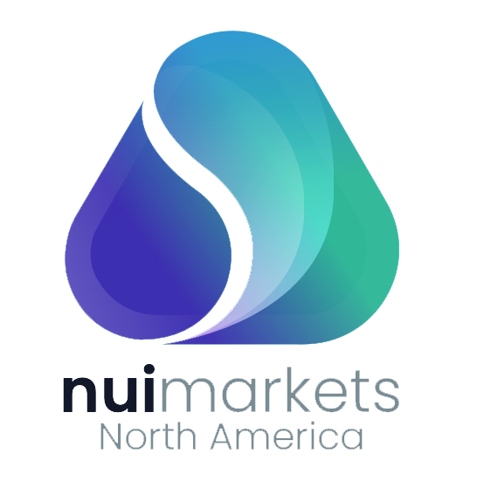
Becoming a platform operator
2
Since 2018, Nui has provided the software for multi seller/multi buyer platforms. However, we are now expanding into the role of platform operator – firstly with DAO and then with Nui Markets North America.
Benefits of Nui becoming the platform operator on our multi seller/multi buyer platforms:
The dairy trader’s involvement in the ownership and operation of DAO presented Nui with a significant challenge.
Because the dairy trader also traded on the platform, there was a misguided perception that they were advantaged over other participants, which deterred some companies from joining the platform.
To combat this issue, we are in the process of completing the acquisition of DAO.
From 1 April, we will be the platform operator with full control over the platform.
We will rebrand the platform Nui Markets Europe later this year.
Increased trust in the platforms as Nui is industry agnostic and does not trade on the platforms. This ultimately attracts more companies to trade on the platforms.
Nui gains a clearer view of customer needs as we are closer to end users.
Nui receives 100% of revenue from the platforms.
Nui can upsell customers, starting them off on a multi seller/multi buyer platform before offering them the option to have their own single seller platform once they are familiar with the technology.
In April 2022, we will launch Nui Markets North America, our second multi seller/multi buyer platform. Nui will be the platform operator.
This will expand Nui’s presence in the North American Dairy Market, where we already provide single seller platforms.
The platforms can be Nui-branded, providing us with an opportunity to grow brand awareness.
We can increase our offering to current customers as we are able to facilitate buyers moving from one of our multi seller/multi buyer platforms to one of our single seller platforms.
DRAFT
Page 9

Slide 10
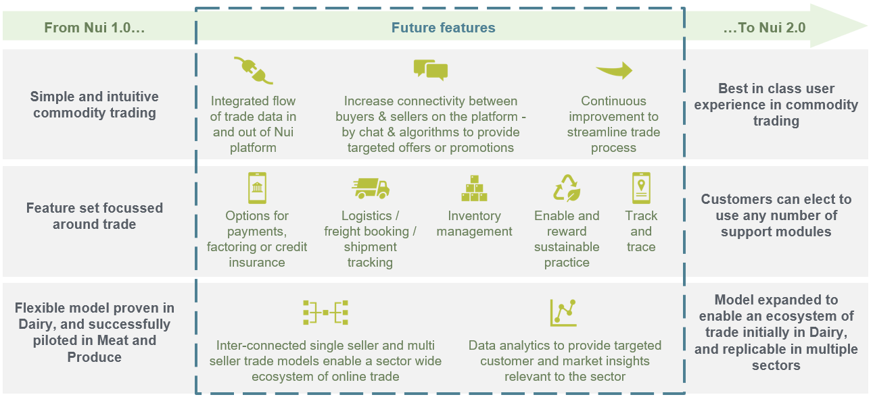
Enhancing platform features
3
The transition from Nui 1.0 to Nui 2.0 will involve the addition of ten features to offer an even more integrated, efficient and transparent way to trade.
DRAFT
Page 10

Slide 11
We’re raising an 8m EUR round at a pre-money valuation of 30m EUR
In 2021, a bridging round of 1.6m EUR was raised which enabled us to begin our expansion. The use of funds were as follows:
We are now looking for European professional investors with a strong track history of supporting international market expansion.
30%: Increase BAU runway by 9 months
30%: Acquire the assets of the DAO (dairy trading) platform to bring this marketplace under the control of Nui. Open up the marketplace to all sellers and operate with independent team. Nui is confident that we can increase volumes, participants and revenue through this marketplace.
20%: Expand DAO into USA by acquiring DAO sellers and establishing local platform ops and marketing team
10%: Add at least one new vertical (Ethanol)
10%: Build Asian Buyer base through Business Development Managers in-market
Recruit key personnel for growth and series A cap raise Continue to acquire key marketplace customers
Use of funds – this Series A round
Significant expansion of marketing and sales functions across new markets.
Continue our exponential growth in existing markets
Improve product third-party integrations to increase breadth of product offering for more competitive markets
Partner/acquire horizontal businesses (payments, trade financing, document management, shipping etc)
Potential to prepare company for IPO
DRAFT
Page 11

Slide 12
This investment will enable us to achieve a projected seven-fold increase in revenue
Revenue growth will come from the acquisition of new customers, the acquisition of DAO Europe, the establishment of a multi seller platform for US dairy and the launch of a platform for ethanol in Brazil. This investment will enable us to achieve the scale necessary to drive growth.
We anticipate 7 fold revenue growth from FY 2021 to FY 2025
DRAFT
Page 12

Slide 13
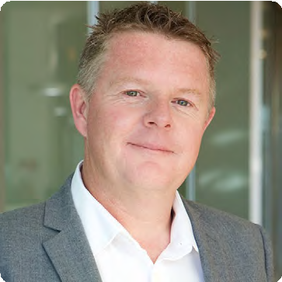
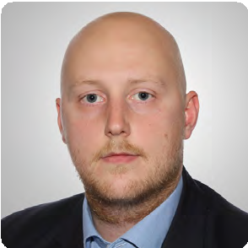
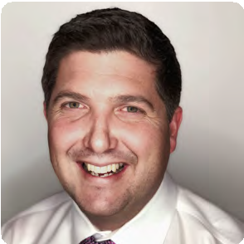
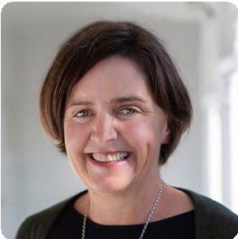
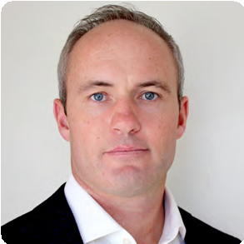
A team of experienced experts in technology and trading
Kevin O’Sullivan - Founder and CEO
"We targeted dairy as our first vertical as we had experience and knowledge in the sector and could see growth in volumes. Volume growth was driven by increasing demand and the increasingly wealthy Asian market. Added to that was the decision from the EU to remove production caps for dairy production, which had been in place since 1984."
Jeppe R.S. Jøker / Europe - Lead
Jeppe is heading up Nui's presence in Europe. Jeppe is a strong sales professional with extensive knowledge of the European dairy trade industry and expertise in sales, logistics and primary industries. Before joining Nui, Jeppe was a key accounts manager at Arla agriculturals, where he played a key role in developing and implementing the Arla Cheese online trading platform.
Jonathan Spurway / Americas - Lead
Jonathan is based in Seattle, Washington and is heading up Sales for Nui with a strong focus on North America. Jonathan has more than 17 years of experience in the agricultural and value-added ingredients sector. From Auckland, New Zealand, Jonathan started his career in the Dairy industry working for Fonterra Group Cooperative. While at Fonterra, Jonathan worked across the globe in technical and commercial capacities, spending time in the Americas, North Asia, China, Southeast Asia and Europe.
Dr. Vladimir Managarov, PhD / Chief Technology Officer
Vladimir specialises in creating complex web-solutions to successfully fulfil business needs. He brings a clear view of time and resource allocation strategies. He has extensive experience in Europe and New Zealand, and prior to joining Nui held a number of senior development roles with Yellow New Zealand, Evanti and Raduga Internet.
Rebecca Swinson / Chief of Customer, Product and Delivery
Rebecca works closely with customers and our technical team to define and deliver platform improvements to meet the varying needs of our customers. Prior to joining Nui, Rebecca led business transformation initiatives for a number of large organisations across many sectors including finance, electricity, telecoms and FMCG sectors.
Governance
Nui’s Board combines extensive experience in the global agribusiness sector with a deep understanding of the role of technology in enhancing international trade. Industry leaders from the likes of Fonterra’s Global Dairy Trade, KPMG, and Open Country Cheese Ltd all make valuable contributions to the governance of Nui.
Ashley Honey / Markets Expansion, Americas
Ashley has more than 15 years' experience in commodities, foreign exchange trading and treasury risk management. Armed with this experience, Ashley has been able to become very knowledgeable on the Ethanol markets in Brazil and the opportunity it presents.
A Growing Company
In 2022, to meet the needs of the business as it grows, we will expand the technical team, establish teams for DAO in Europe & the multi seller in the US, and engage in-market agents in Asia. Beyond this, we will bring on resources to support expansion into new sectors and separate operational & change responsibility to enable the right levels of support.
DRAFT
Page 13

Slide 14
Thank you!
DRAFT

Slide 15
Appendix – Cashflow Statement
3-year cashflow statement - Detailed
DRAFT

