Slide 1
Investor Pitch Deck – March 2022
Simplifying the world of commodity trading with our efficient, transparent, and digital trade platform.
DRAFT

Slide 2
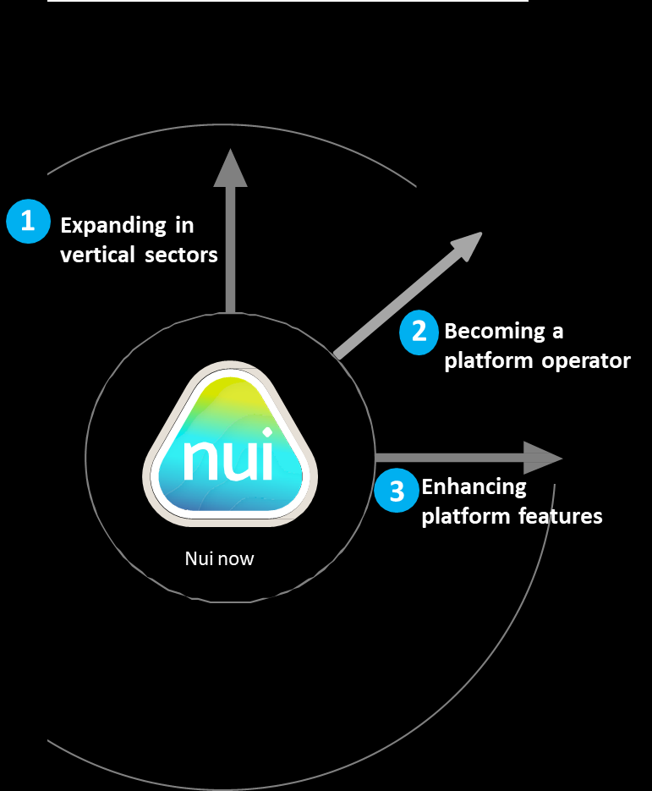
Summary
The timing is right to expand. We are looking for a growth capital partner to join our journey.
The next chapter
Nui aims to become an industry leader in commodity trading through embracing three key paths to growth.
Nui Markets provides a configurable co-branded platform for agricultural commodity trading – both as a single seller digital channel and as a multi seller marketplace. This platform is used by 287 companies in 47 countries. Since inception in 2016, NZD$755M of GMV has been traded through our platform. We have identified an opportunity to rapidly expand and consolidate our platform globally. We are now seeking 8m EUR of equity capital at a 30m EUR pre-money valuation.
This growth capital will enable us to become an industry leader in commodity trading through embracing three key paths to growth:
Nui is beginning to experience exponential growth – with 122% annual revenue growth in 2021 and almost 300% in trade volume. By receiving the funding we need to truly scale our offering, we forecast a 7 times increase in revenue growth over the next four years.
In the last year we have focused on fine-tuning our core offering of efficient & intuitive online trade. Our flexible model & broad range of trade features enables any agricultural commodity trader or exporter, anywhere in the world, to join our ecosystem and trade conveniently.
We have a proven product and a scalable platform. The adoption of digital trading within agricultural commodity markets has meant that we are at the right place, at the right time to become a category leader. Nui, in Maori means ‘big’, ‘great’ or ‘abundance’ - those words adequately convey our ambition to be the largest global agricultural commodity trading platform.
Grow our “platform as a service” offering in new verticals
Become a marketplace operator in our chosen dairy markets
Enhance platform features to add more value to our users’ trading
DRAFT
Page 2

Slide 3
Global commodity trading needs an upgrade
– that’s where we come in.
The size of the prize ($USD) for food commodity trading
Despite living in a time of great technological advances, the way agricultural commodities are physically traded on the spot market has remained antiquated. Traders rely on personal relationships and are dependent on finding the right buyer at the right time, at the right price. Typical sales teams communicate directly with customers on a one-to-one basis across many channels such as Whatsapp and email. Agreeing and administering trade of agricultural commodities is thus labour intensive and difficult to scale.
Admittedly, COVID-19 has accelerated the uptake of digital solutions for traditional trade. However, existing solutions built on generic frameworks like Magento or Mirakl fail to cater to the complex workflow requirements of agricultural commodity export/import.
As a result, traders suffer from poor price discovery, high costs of searching for trading partners, administrative inefficiencies, pressured margins, and increased counterparty risk when trading with unfamiliar partners.
The prize for serving this unmet need is immense. We have only begun to tap into the global opportunity to provide our fit-for-purpose platform to agricultural commodity traders everywhere.
$1.6T
Global traded exports of all food
commodities in 2020
$800B
Presuming we can serve half of the
industry verticals
$4B
Global commissions available presuming a 50% revenue share of a 1% commission
Fish Global trading market
$401 billion
Eggs Global trading market
$108 billion
Ethanol Global trading market
$141 billion
$200M
Possible Nui revenue obtainable
assuming a 5% market share
DRAFT
Page 3

Slide 4
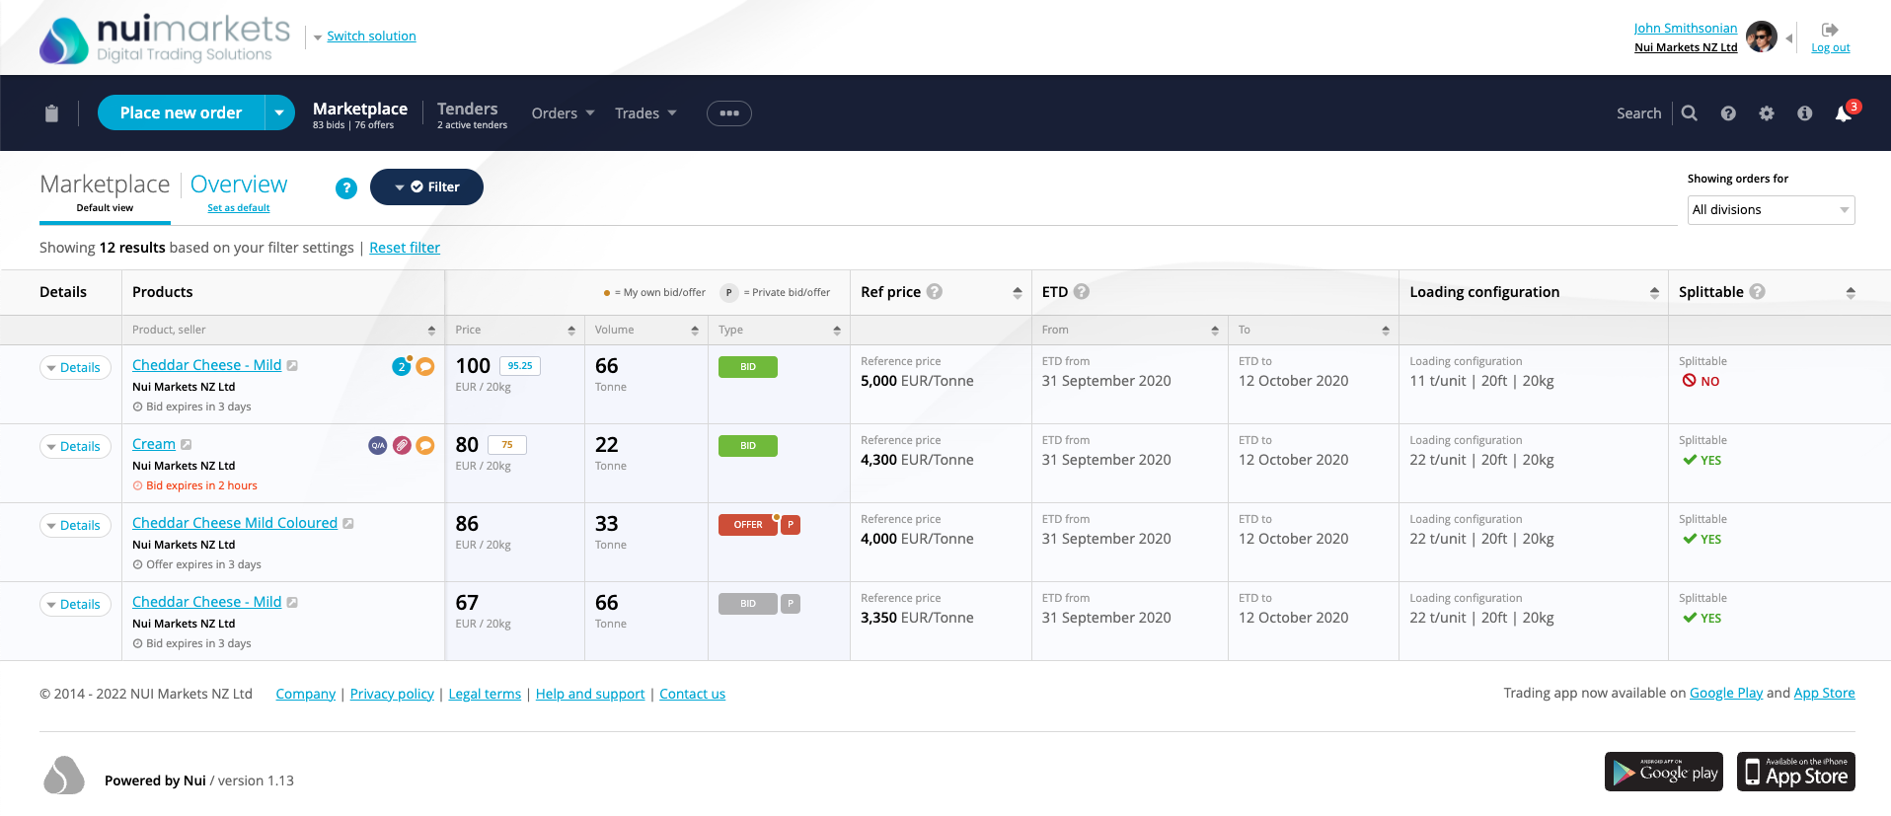
We’ve built a fit-for-purpose platform for agricultural commodity trading which our customers and users love.
Six years ago, we created a “Platform as a Service” business providing white-label platforms for use as private digital channels for single exporters. Soon after, our platforms started to be used by independent marketplace operators to run multi seller digital marketplaces.
We are now expanding into the role of platform operator and will control and consolidate our multi seller/multi buyer platforms in Europe and North America.
We have three forms of income: implementation fees, subscription charges, and trade commissions.
Nui platforms provide:
Increased trade efficiency
Improved price transparency
Enriched market info
Expanded market access
Nui platforms streamline the sales process, reducing the time and effort required for a trade to take place. When you start using a Nui platform, this increased level of efficiency is noticeable right from the first trade.
Nui platforms make trading less opaque through ensuring that trade occurs at a true market price which is visible to all participants. This ultimately reduces negotiation tension and encourages trade.
Nui platforms take the guesswork out of pricing new products as sellers can ‘test the waters’ with open price offers and accurately gauge the level of market demand.
Nui platforms provide an efficient way for sellers to engage with more buyers, more regularly with the same level of resources. Consequently, sellers can capture more demand whilst buyers have greater access to a wider range of products.
DRAFT
Page 4

Slide 5
How Nui has enabled Hilmar Cheese to realise the benefits of digital trading
Case Study – Hilmar Cheese Company
The challenge
Hilmar Cheese Company was looking for a way to sell the off-spec products in their “Opportunity Cheese Division”, while simultaneously using the levers of the sales process to maximize price discovery.
The platform
The new digital platform - Hilmar Connect - quickly established itself as a success. Sales exceeded initial expectations and their customers were energized by the new buying option.
For over a year, Hilmar have run weekly auctions on the platform with all of their off-spec offerings. In February 2022, they started to also sell some of their first-grade products through auctions on the platform.
Additionally, Hilmar has had success using the platform’s open marketplace function. The marketplace provides a space for both Hilmar and their customers to place bids and offers on approved products. This allows Hilmar to quickly get a sense as to what a given product is worth to their customers.
Partnering with Nui Hilmar believed that they could improve their inefficient sales process, which involved countless phone calls and emails, by tapping into the benefits of digital trading. Initially, Hilmar considered building their own platform, but quickly realized this would require an outsized investment both in terms of time and money, so instead they identified Nui as a partner.
Hilmar provided Nui with an understanding of their requirements and within weeks Hilmar had a working single seller platform with all the features needed to trade their off-spec products digitally.
Outcomes
Utilizing Nui’s open marketplace and live auction functions, Hilmar has enjoyed the following key benefits:
Price discovery
Transactional transparency
Round the clock availability
Access to a broader customer base
On HilmarConnect (as of end of Feb 2022)
1,213 26,034 $111M
Trades Tonnes traded Face value traded
(NZD)
Quote from Hilmar
DRAFT
Page 5

Slide 6
With $755M NZD traded since 2016, we are starting to experience exponential growth
As of end of February 2022, Nui had over 287 companies accessing a Nui platform, in 47 countries. In the 12 months to end of Feb 2022, over 1,860 trades were completed, totaling 65,188 tonnes with a GMV of over NZD$282M. We have experienced exponential revenue growth with total revenue in NZD increasing from $0.259M in FY2017 to $0.807M in FY20 and $1.517M in FY21.
Since inception (as of end of Feb 2022)
Current Users (In 12 months to end of Feb 2022)
3,882 192,000 $755M
Trades Tonnes traded Face value traded
(NZD)
1,140
287
47
Users
Companies
Countries
represented
Total Revenue of $1.52 million NZD for FY2021
Revenue CAGR of 55.5% for the period FY2017 to FY2021
GMV CAGR of 61.5% for the period FY2017 to FY2021
DRAFT
Note: FY2017 is 1 July 2016 to 30 June 2017
Page 6

Slide 7
Our success to date is a product of our unique value proposition and competitive advantage
Our competitive advantage:
Our ability to seamlessly white label the platform so it looks and feels like it belongs to our customer
Our clean & intuitive interface that separates users from the complexity of trade
Our status as industry agnostic – we are not affiliated with any major trader
Our expertise in commodity trading
Our commitment to allowing our customers to set the rules of what, when and with whom they trade
Name | Founded | Origin | Features | What sets Nui apart – our unique value proposition
1. | 2015 | South Korea | Digital platform Technology plus human network connecting buyers and sellers globally Help importers and exporters understand global market of food and agri | Ability to seemlessly make the platform look and feel it belongs to our customer (eg branding and language) Our clean & intuitive interface separates users from the complexity of trade Live auctions
2. | 2008 | New Zealand | Work with companies around the world to discover the market-based reference prices for dairy Create new trading opportunities Toolkit for connecting global pools of buyers and sellers Data analysis | We stand alone - not affiliated with a major trader (i.e. Fonterra) Our customers set the rules of what, when and with whom they trade GDT index effectively sets the price of NZ milk - we have the ability to do that for other markets (US and Europe)
3. | 2011 | France | Advanced enterprise marketplace SaaS platform B2B and B2C Connects ecosystems | Industry expertise and knowledge of commodity trading
4. | 2014 | USA | Finance (factoring) | Industry agnostic
Faster launch
Wide array of payment solutions Partner to growers
Live auctions
DRAFT
Page 7

Slide 8
The next chapter in our journey
Nui aims to become an industry leader in commodity trading through embracing three key paths to growth.
1
Expanding in vertical sectors
2
Becoming a platform operator
3
Enhancing platform features
Nui now
DRAFT
Page 8

Slide 9
Expanding our “platform as a service offering” across our vertical sectors
@Wim/Joanna – For slides 9/10/11, in top right corner insert diagram from slide 8
1
Double-down on dairy
Expand in ethanol in Brazil
Explore new sectors
Pilot customers in produce, meat and now ethanol confirm to us that the Nui platform can be effective in many sectors.
We do recognise, however, that to succeed we need the right partners and a strong knowledge of the sector.
We want to focus in on true commodity markets with a large spot market and a large number of buyers and sellers.
A discovery phase will be undertaken in a number of sectors to further determine fit - sectors recently identified include eggs, fertiliser, animal feed, carbon and biofuel.
Alongside this, we remain opportunistic and will consider further pilot customers where practical.
Build an Asian buyer base
We’ll use our experience in dairy and other sectors to build out a strong online trading ecosystem for ethanol.
A year-long discovery exercise has allowed us to confirm there is a strong business case to proceed with this.
The platform itself will use functionality in place within the DAO model.
Once commercials are in place, we’ll work with our partner in Brazil on a detailed implementa tion plan including user set-up and training.
Trading through the platform will improve trade efficiency for all partners and bring with it the market transparency that all parties seek.
We are aiming to launch the ethanol platform in July.
Identifying dairy buyers in Asia and introducing them to our international platforms will increase the volume traded. Nui will own the customer relationship.
We will engage in-market agents in South-East Asia to drive liquidity.
Further expand multi seller/multi buyer platform operated model
We will create a multi seller/multi buyer dairy platform operated model in North America during Q2 2022.
2022
July 2022 – end of 2023
From January 2023
DRAFT
Page 9

Slide 10
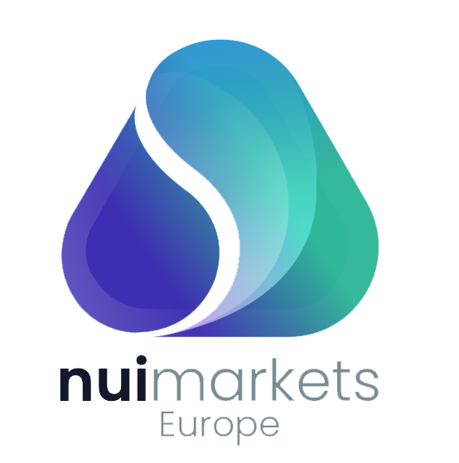
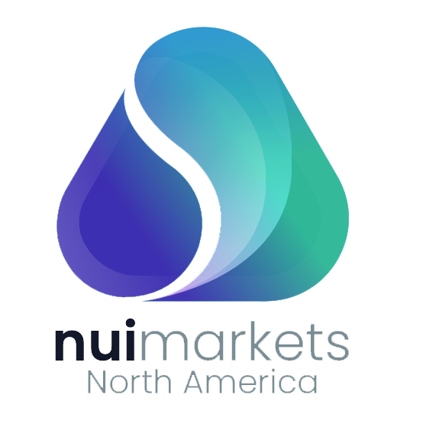
Becoming a platform operator
2
Since 2018, Nui has provided the software for multi seller/multi buyer platforms. However, we are now expanding into the role of platform operator – firstly with DAO and then with Nui Markets North America.
DAO was owned and operated by a prominent European dairy trader. Because this trader also traded on the platform, there was a misguided unwillingness by competing traders to use the platform and risk advantaging their competitor.
To combat this issue, we are in the process of completing the acquisition of DAO, which will make the platform independent of any market participant.
From 1 April, we will be the platform operator with full control over the platform. We will rebrand it ‘Nui Markets Europe’ later this year.
Benefits of Nui becoming the platform operator on our multi seller/multi buyer platforms:
Increased trust in the platforms as Nui is industry agnostic and does not trade on the platforms.
Nui gains a clearer view of customer needs as we are closer to end users. Our overall industry knowledge increases.
Nui receives 100% of revenue from the platforms.
Since the announcement of the acquisition of DAO, which will make it industry agnostic and independent, we have historical companies that reactivated their account and 4 new companies that have joined the platform. This gives a total of 95 companies trading on DAO.
Nui can upsell customers, starting them off on a multi seller/multi buyer platform before offering them the option to have their own single seller platform once they are familiar with the technology.
In April 2022, we will launch Nui Markets North America, our second multi seller/multi buyer platform. Nui will be the platform operator.
This will expand Nui’s presence in the North American Dairy Market, where we already provide single seller platforms.
The platforms can be Nui-branded, allowing us to grow brand awareness.
We can increase our offering to current customers as we are able to facilitate buyers moving from one of our multi seller/multi buyer platforms to one of our single seller platforms.
DRAFT
Page 10

Slide 11
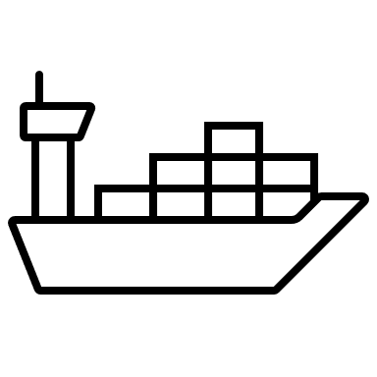
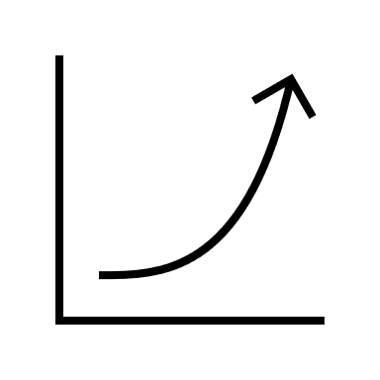
Enhancing platform features to drive revenue growth
3
Our third path to growth will see us developing new features to drive an increase in trade volume.
Increasing flexibility of trade
Targeted offers and promotions
Expand trade functionality to enable trading outside of spot market
Focus on flexibility in order formats
Further improving trade efficiency
We will increase trade volume on Nui platforms through:
Options for payments, factoring, or credit insurance
Freight/logistics
Integrated flow of data in and out
Customer insights to strengthen sales process
Trade insights to highlight areas to improve or target
Supporting our customers’ business initiatives
Enable and reward sustainable practice
Track and trace
Boosting user engagement
Insights through analytics
Vital information right at your fingertips
Show the value of the platform – easily shareable
Increased connectivity between buyers and sellers and Nui
DRAFT
Page 11

Slide 12
We’re raising an 8m EUR round at a pre-money valuation of 30m EUR
In 2021, a bridging round of 1.6m EUR was raised which enabled us to continue our expansion, acquire DAO, and further expand the development of ethanol in Brazil.
We are now looking for European professional investors with a strong track history of supporting international market expansion.
Use of funds – this Series A round
x%: Identify, build and develop service offering in new verticals
x%: Increase BAU runway for 24 months (to September 2024)
X%: Scale Nui Markets Europe and refresh brand positioning
X%: Develop and scale Nui Markets North America
X%: Finalise our Ethanol trading platform
X%: Expand in Asia to develop a strong buyer base
X%: Further expand our technical footprint to deliver on our roadmap
X%: Prepare for Series B/listing opportunities
X%: Develop Nui global marketing and comms footprint
X%: Develop ESG plan
X%: Co-Founder exit
DRAFT
Page 12

Slide 13
This investment will enable us to achieve a projected seven-fold increase in revenue
Revenue growth will come from the acquisition of new customers, the acquisition of DAO Europe, the establishment of a multi seller platform for US dairy and the launch of a platform for ethanol in Brazil. This investment will enable us to achieve the scale necessary to drive growth.
We anticipate a 7-fold growth in revenue from FY 2021 to FY 2025
DRAFT
Page 13

Slide 14
A team of experienced experts in technology and trading
Kevin O’Sullivan - Founder and CEO
"We targeted dairy as our first vertical as we had experience and knowledge in the sector and could see growth in volumes. Volume growth was driven by increasing demand and the increasingly wealthy Asian market. Added to that was the decision from the EU to remove production caps for dairy production, which had been in place since 1984."
Jeppe R.S. Jøker / Europe - Lead
Jeppe is heading up Nui's presence in Europe. Jeppe is a strong sales professional with extensive knowledge of the European dairy trade industry and expertise in sales, logistics and primary industries. Before joining Nui, Jeppe was a key accounts manager at Arla agriculturals, where he played a key role in developing and implementing the Arla Cheese online trading platform.
Jonathan Spurway / Americas - Lead
Jonathan is based in Seattle, Washington and is heading up Sales for Nui with a strong focus on North America. Jonathan has more than 17 years of experience in the agricultural and value-added ingredients sector. From Auckland, New Zealand, Jonathan started his career in the Dairy industry working for Fonterra Group Cooperative. While at Fonterra, Jonathan worked across the globe in technical and commercial capacities, spending time in the Americas, North Asia, China, Southeast Asia and Europe.
Dr. Vladimir Managarov, PhD / Chief Technology Officer
Vladimir specialises in creating complex web-solutions to successfully fulfil business needs. He brings a clear view of time and resource allocation strategies. He has extensive experience in Europe and New Zealand, and prior to joining Nui held a number of senior development roles with Yellow New Zealand, Evanti and Raduga Internet.
Rebecca Swinson / Chief of Customer, Product and Delivery
Rebecca works closely with customers and our technical team to define and deliver platform improvements to meet the varying needs of our customers. Prior to joining Nui, Rebecca led business transformation initiatives for a number of large organisations across many sectors including finance, electricity, telecoms and FMCG sectors.
Governance
Nui’s Board combines extensive experience in the global agribusiness sector with a deep understanding of the role of technology in enhancing international trade. Industry leaders from the likes of Fonterra’s Global Dairy Trade, KPMG, and Open Country Cheese Ltd all make valuable contributions to the governance of Nui.
Ashley Honey / Markets Expansion, Americas
Ashley has more than 15 years' experience in commodities, foreign exchange trading and treasury risk management. Armed with this experience, Ashley has been able to become very knowledgeable on the Ethanol markets in Brazil and the opportunity it presents.
A Growing Company
In 2022, to meet the needs of the business as it grows, we will expand the technical team, establish teams for DAO in Europe & the multi seller in the US, and engage in-market agents in Asia. Beyond this, we will bring on resources to support expansion into new sectors and separate operational & change responsibility to enable the right levels of support.
DRAFT
Page 14

Slide 15
Thank you!
DRAFT

