Slide 1


Nui Marketplace - North America
An open marketplace for the trade of dairy commodities

Slide 2

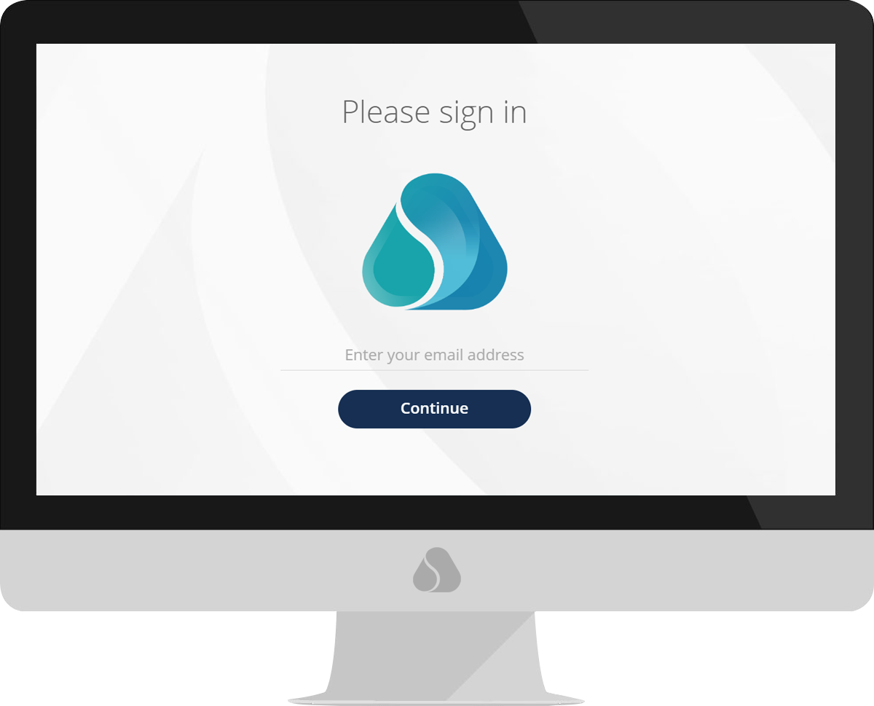

What is Nui Marketplace – North America?
An open marketplace for dairy commodity trading, initially within North America
Brings together a collection of trading partners, all of whom can buy or sell to pre-approved participants
Offers a standardised product set and rules of trade
Gives participants the opportunity to efficiency source or sell dairy products, anywhere, anytime.

Slide 3
Consistent across all Nui plans
Nui offers multiple plans, to best suit your specific needs. Regardless of which plan you choose, all plans offer the following essentials
Secure, cloud-based infrastructure
Proven technology - our platforms are in regular use by 400+ companies in more than fifty countries
Accessible via desktop or mobile app
Training and 24/7 technical support is available for all participants

Slide 4
Our experience in Dairy
Private dairy platforms in North America
Nui Markets in Europe - DAO.EU
Nui host private platforms for dairy companies in the US, Europe, and New Zealand.
40+ US-based companies participate on these platforms.
In 2021, there were over 5,000,000 pounds traded on Nui platforms in the US.
DAO.EU is a dairy commodity marketplace based in Europe, established in 2017.
In 2021 alone, 208 unique traders traded over 44,000,000 pounds of dairy commodities on the DAO platform.
It allows participants to source or sell dairy products anywhere, anytime
efficiently.

Slide 5
Why use Nui Marketplace North America?
The key benefits
Gain market information
Provide price discovery and transparency of dairy commodities
Pricing tension is reduced when all parties have
visibility of the market price
Improved trade efficiency
Days long processes now happen with just one click
Reduced spending on transactional activity allows for value-added activity
Broaden your network
Small and medium
companies can easily expand their customer base
Ability to test the market price with a broader group

Slide 6
How do we compare to CME
What we offer
What the CME offers
An open marketplace that is available 24/7 – ready to use when it works for you
Broader product set
Real-time market price transparency
Transparency of product details and the location of what you are buying
Flexible delivery offerings
Easy to set up and simple to use
Scheduled daily event/time
Defined products with:
- Rigid specs and DOM range
- Defined and unrealistic freight
allowances
Lack of transparency of product details and current location of the product
Key purpose is to set an index that informs the market/sets the farm-gate price

Slide 7
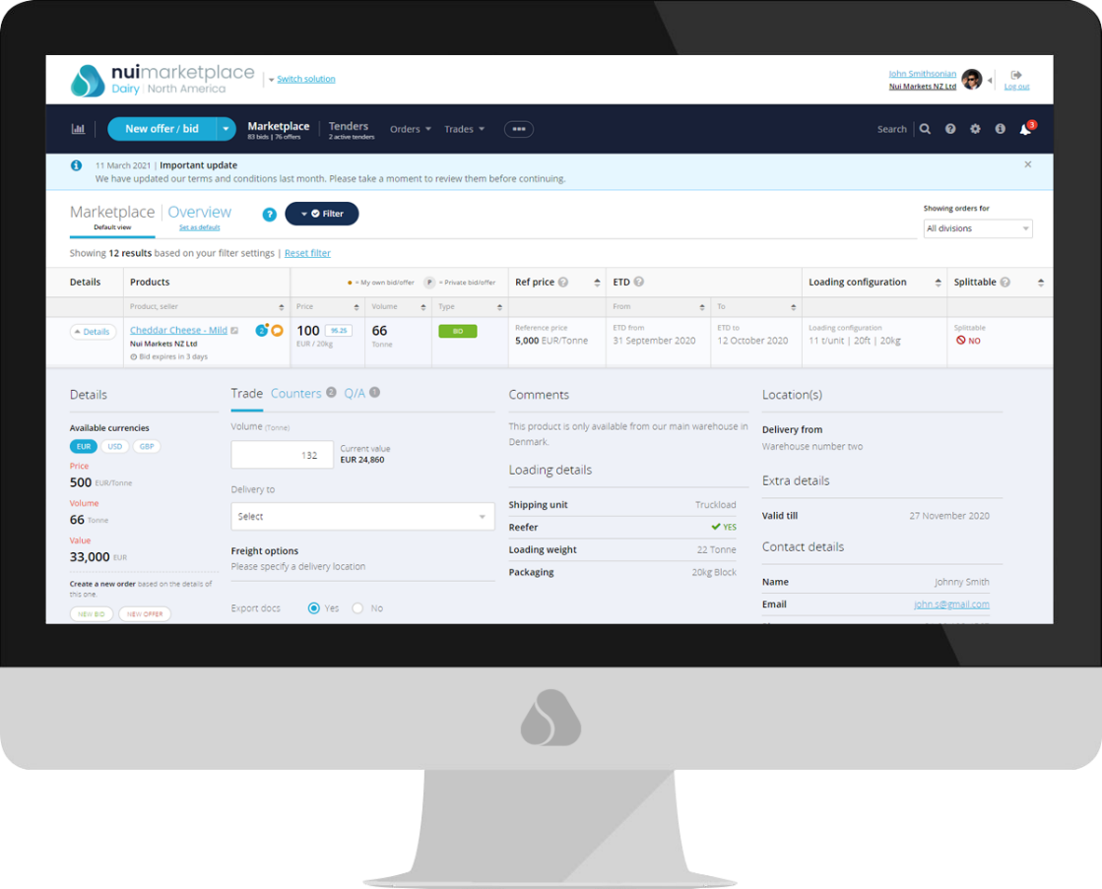
Better trade outcomes start here
Cost
Monthly subscription of $3000
Paid semi-annually in Jan and July
No implementation costs
No commission

Slide 8
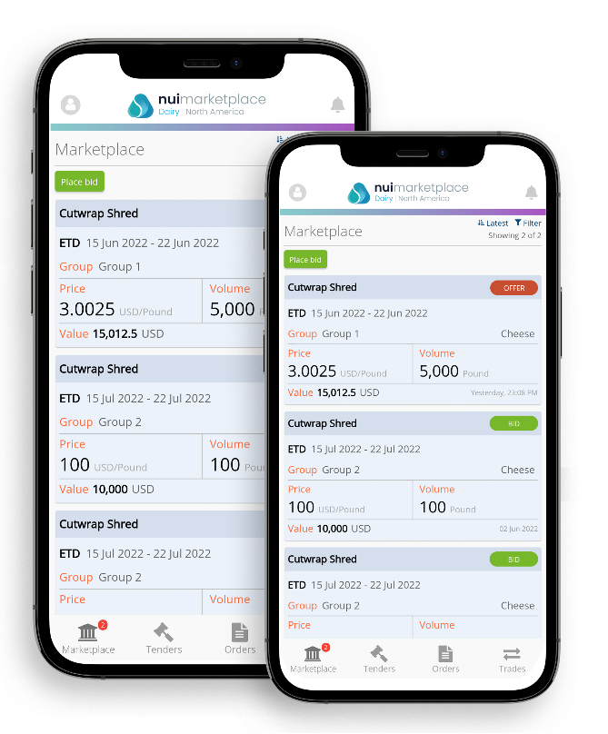
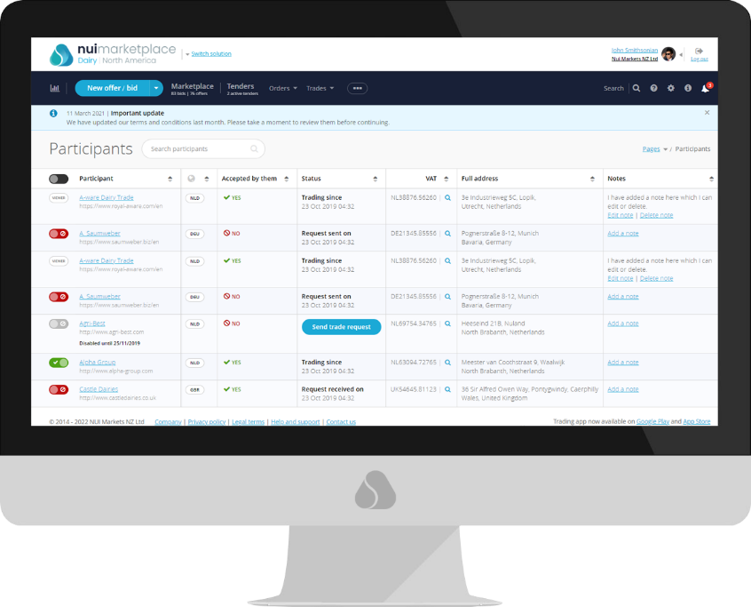
Choose who you trade with from wherever you are
The Participant selector allows you to choose who you trade with, and under what terms
Nui Marketplace is accessible on your desktop and via the Nui Mobile app

Slide 9

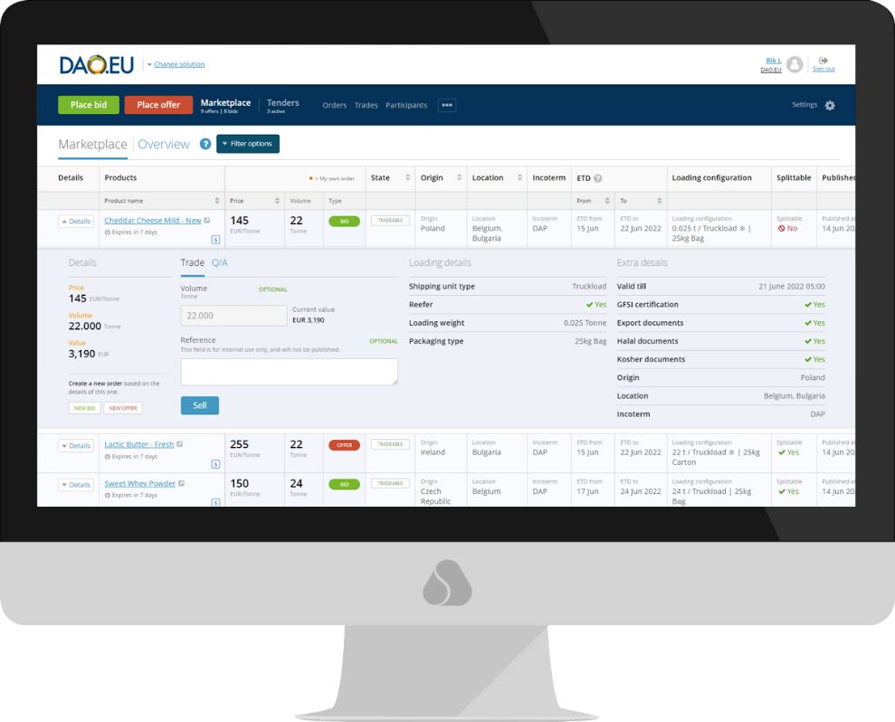
Access market information
Gain real time market insights
Gain a window into European dairy trade

Slide 10

Thank you!

