Slide 1


Nui Markets - North America
An open marketplace for the trade of dairy commodities
February 2022

Slide 2

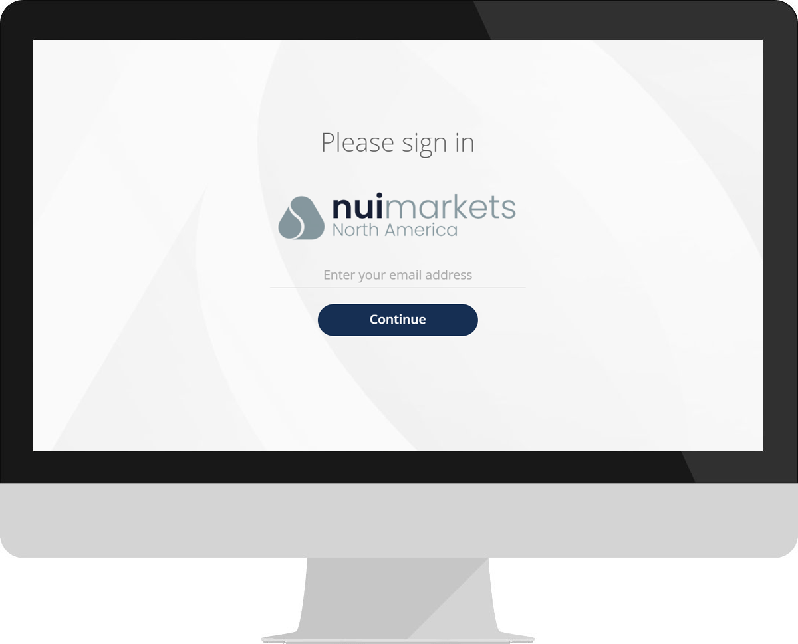

What is Nui Markets – North America?
An open marketplace for dairy commodity trading, initially within North America
Brings together a collection of trading partners, all of whom can buy or sell to pre-approved participants
Offers a standardised product set and rules of trade
Gives participants the opportunity to efficiency source or sell dairy products, anywhere, anytime.
Launching in the US in April 2022

