Slide 1





Introducing Nui Markets
Nui Markets is a Software as a Service business providing digital B2B marketplaces for global agricultural producers.
We enhance client | customer connections through an easy and efficient digital trading inter- face.
With Nui, the transition to digital trading is hassle free and delivers substantial dividends to all our partners.

Slide 2


Why digital
Discover a better way
More and more businesses are pursuing a digitization strategy. This shift in thinking highlights that B2B ecommerce has numerous advantages, including:
Increased trade efficiency
Improved customer service with increased customer contact and engagement
Price transparency – all parties can determine the true market price Price achievement for all parties – with reduced negotiation tension

Slide 3

And that’s where we come in?
We are Nui
Established
Founded in New Zealand in 2012. In partnership with Valio since 2019
Transparent
Nui platforms work to give both buyers and sellers market transparency
Trade made easy
Trade can be just one click away, 24 hours a day, 7 days a week from wherever you are
Proven
Nui platforms are regularly by 400+ companies in more than fifty countries. To date, hundreds of millions of euros worth of product have been traded.
User friendly
User feedback is a key driver in our development roadmap. Our design is continually evolving to ensure the best experience for those who use it.

Slide 4
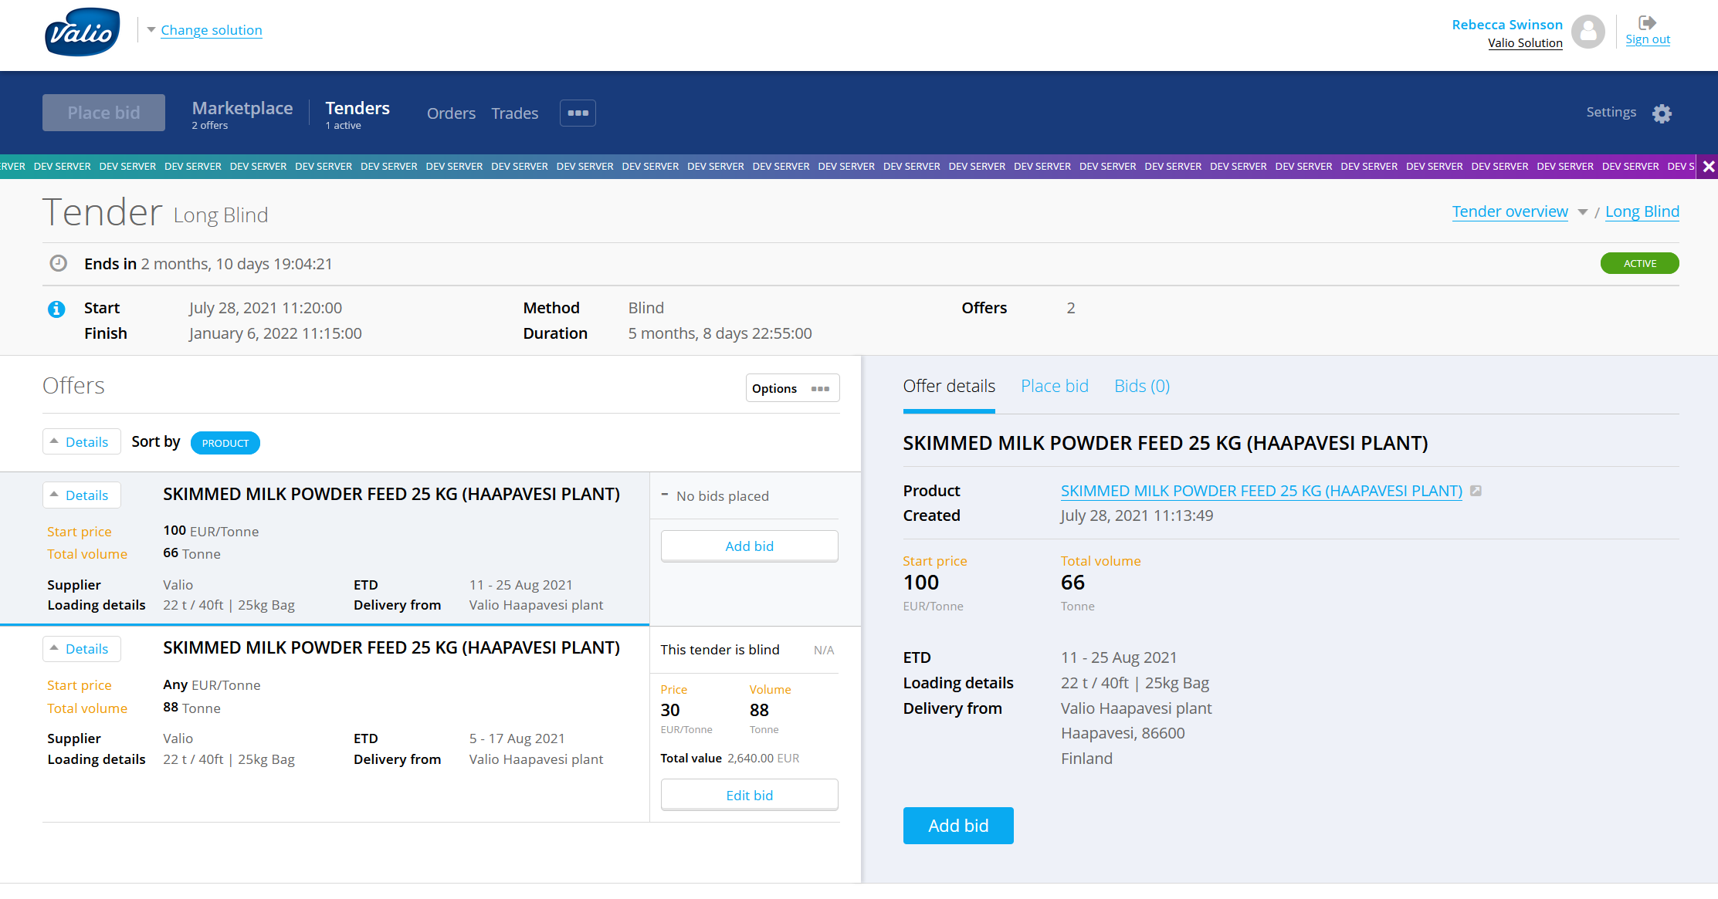
Regular tender events
Easy to use, provides insightful market information

Slide 5
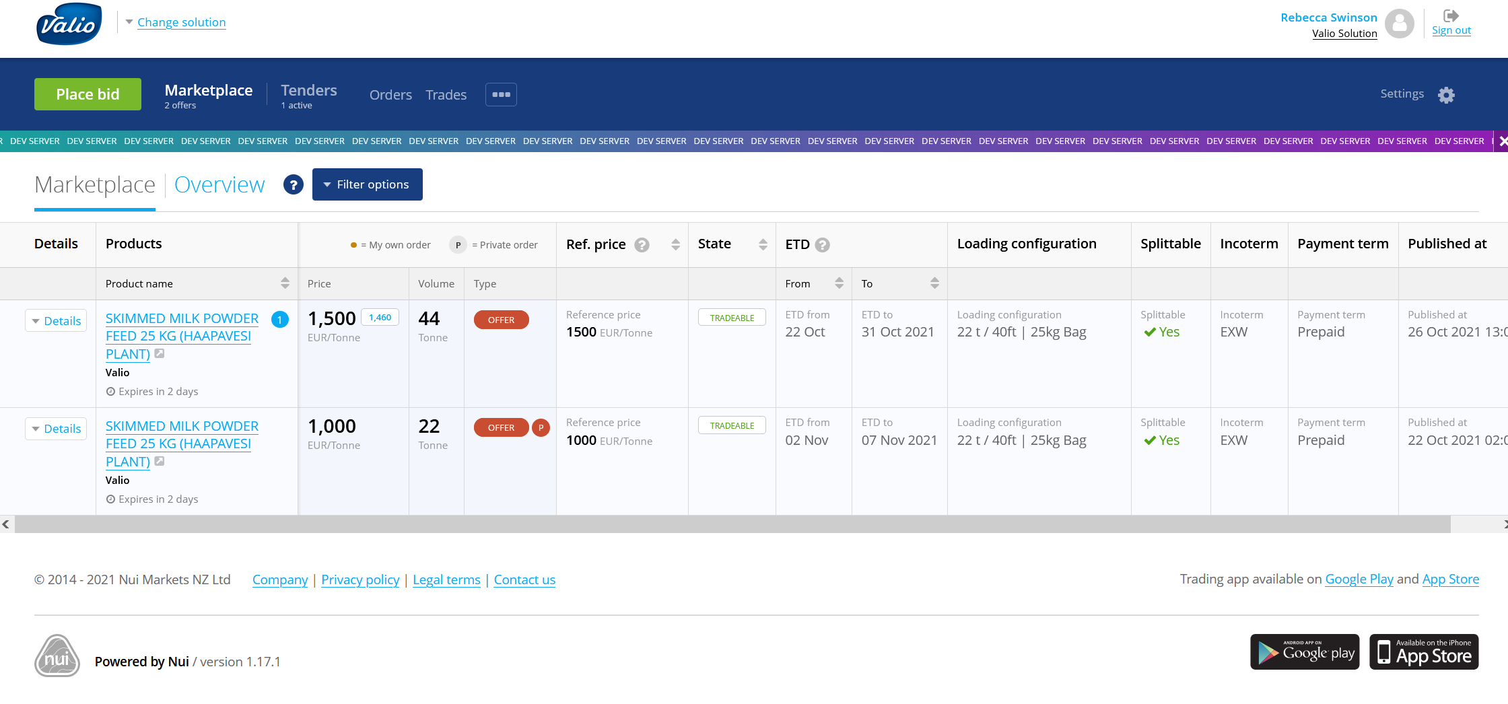
Trading on the marketplace
Trade, counter or request to buy
Established
Founded in New Zealand in 2012. In partnership with Valio since 2019
Transparent
Nui platforms work to give both buyers and sellers market transparency
Trade made easy
Trade can be just one click away, 24 hours a day, 7 days a week from wherever you are
Proven
Nui platforms are regularly by 400+ companies in more than fifty countries. To date, hundreds of millions of euros worth of product have been traded.
User friendly
User feedback is a key driver in our development roadmap. Our design is continually evolving to ensure the best experience for those who use it.

Slide 6
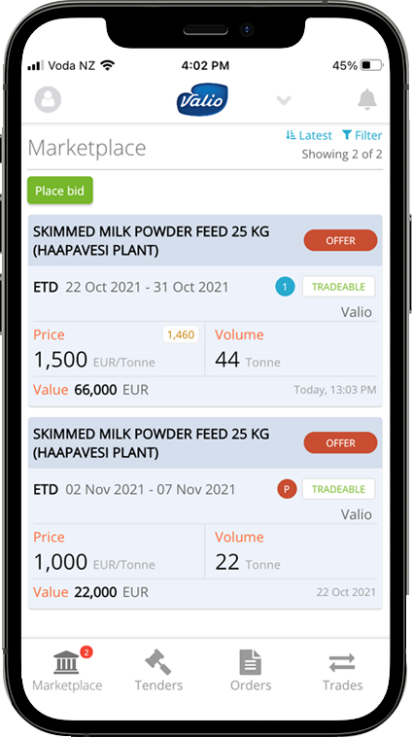
Trade on the go
Mobile App
Get notified of new offers
Configurable to receive the information you need directly to your device
Marketplace
Ask a question, counter or trade, and Valio will get straight back to you
Tender
View or bid a tender from wherever you are

Slide 7
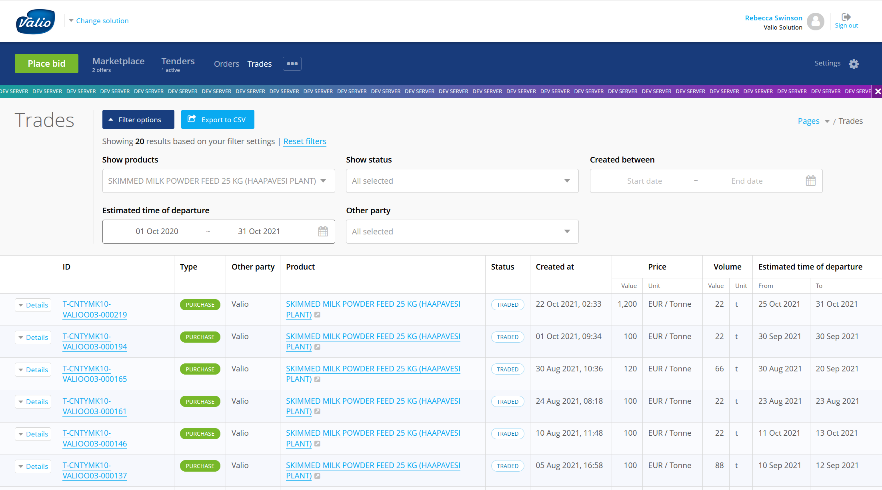
Overview of market activity
Record of all your trades, for easy analysis
Get notified of new offers
Configurable to receive the information you need directly to your device
Marketplace
Ask a question, counter or trade, and Valio will get straight back to you
Tender
View or bid a tender from wherever you are

Slide 8

Thank you!

